Slide 2
What is Alaska STEPP
Alaska STEPP, which stands for Steps Toward Educational Progress and Partnership, is an online, school improvement planning tool based upon Indistar, a software template. Twenty-four states, including Alaska, currently use the software program to serve school, and district-level, improvement planning.

Slide 3
Alaska STEPP is based on the
Continuous Improvement Model
Plan
Create
Implement
Monitor
(plan)
Assess
Revise
(plan)
Notes:
Alaska STEPP is a tool that facilitates a shift in the improvement planning process from one year plans addressing only compliance-related requirements to a continuous process of assessing, planning, and self-monitoring.
It assists teams in setting up plans that are strategic because key areas are assessed first
It assists teams in avoiding the planning whirlpool with a built in self monitoring mechanism
It adapts to the changing nature of schools by allowing for revisions based on the results of the monitoring

Slide 4
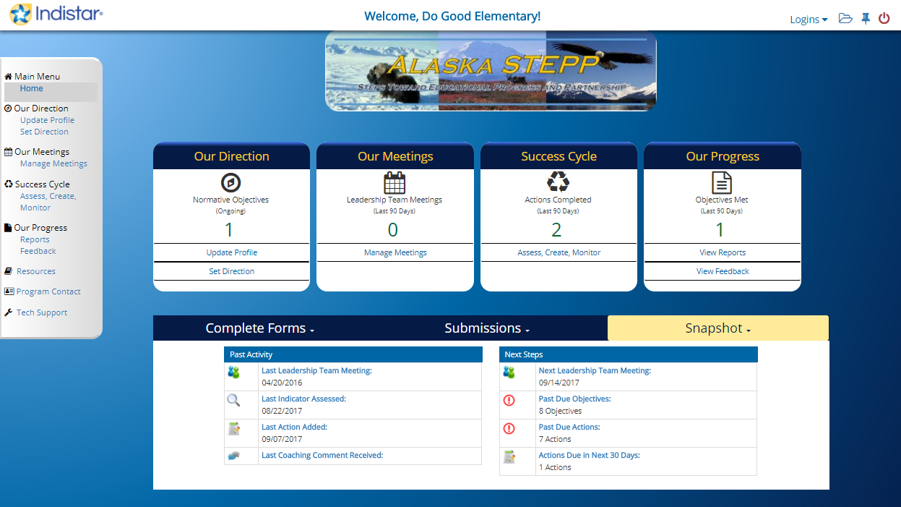
The Alaska STEPP Program Provides the Structure to Implement Effective Processes.
There isn’t a once a year paper plan for compliance, rather continuous planning is a process that is never done.
Notes:
Paper plans get written and placed on a shelf. By Jan. or Feb plans paper plans are not looked at. Continuous planning is a paradigm shift. It’s a process that is never done. School improvement plans on Alaska STEPP can be a picture and a reflection of what is happening at schools.
One place to record everything that is happening at a site pulling plans of different programs together.
Since the improvement plan is continuous, at the beginning of a new school year, a site just needs to make some adjustments to their plan and push the submit button.
User friendly.

Slide 5

Alaska STEPP Includes
Research Based Practices
The Domains, Indicators, Rubrics, and
WiseWays provide benchmarks for
measuring school effectiveness.
Notes:
The indicators in Alaska STEPP originally came from the Alaska audit tool, developed by the department to comply with statutes created by the legislature to determine if Alaskan schools were in need of additional support.: Alaska’s Effective Schools Framework.
The domains and indicators of effective practice are drawn from both national education research and the priorities of the Alaska Department of Education
& Early Development.

Slide 6
More About Alaska STEPP
Since its development and customization for Alaska five years ago, several Alaska districts have adopted STEPP as a way to incorporate continuous, comprehensive, and team-oriented school improvement planning. Currently Alaska STEPP is the required method for writing and implementing school improvement plans for 1-, 2-, and 3-star schools, as well as for Priority and Focus schools and districts.

Slide 7
Alaska STEPP’s Framework
The tool is built around the six domains of effective schools: Curriculum, Assessment, Instruction, Supportive Learning Environment, Professional Development, and Leadership. Within these six domains are 32 indicators with rubrics against which school improvement teams can assess their school and focus improvement efforts. This tool is more than a software system that produces a plan for submission; it is designed to encourage a school improvement process that is ongoing and task driven, resulting in continuous engagement and improvement.

Slide 8

Alaska STEPP is a
Place to Build a Structure
The indicators of effective practice are the framework that supports the school.
Notes:
Framework: An organizational structure for systematically addressing the challenges schools face. The indicators are the walls that hold up the building.

Slide 9
The Six Domains
  Curriculum
  Assessment
  Instruction
  Supportive Learning Environment
  Professional Development
  Leadership
  Within those domains are 32 indicators with assessment rubrics.
Notes:
These domains include practices that are proven indicators of school success. The indicators themselves are a baseline to measure school success; they are an instrument for schools to use in assessing how effective their practices are. Title I, domain 8, includes four indicators for schools with Title I schoolwide plans to assess. There is no domain 7.

Slide 10
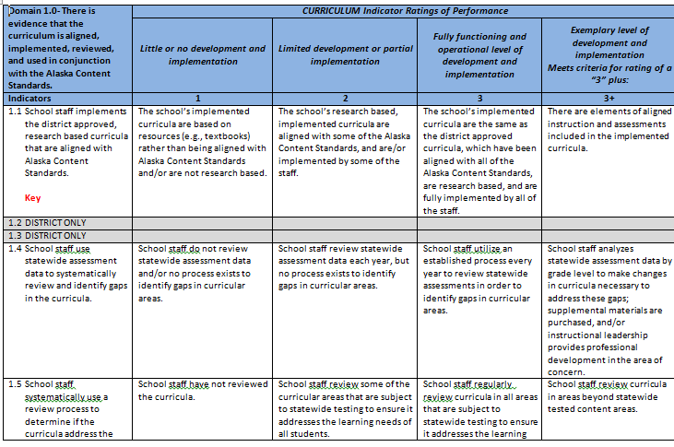
Domains and
Indicators Rubric

Slide 11
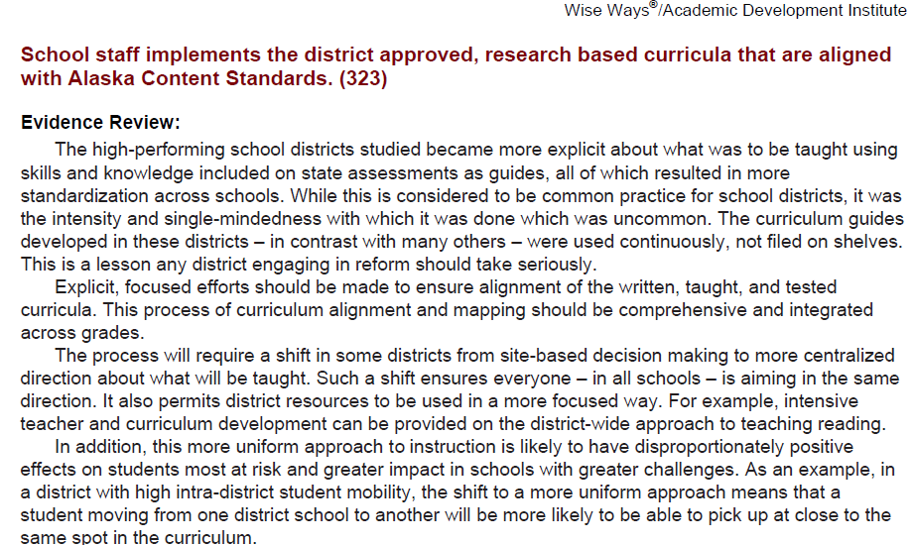
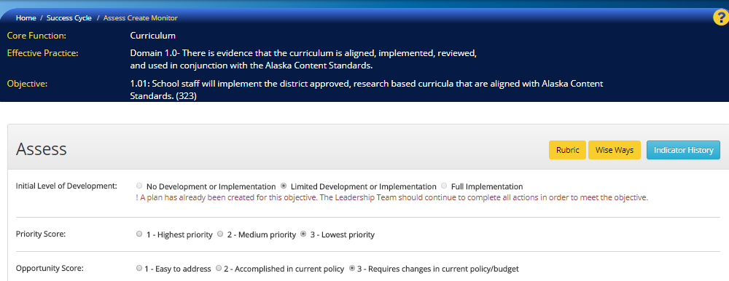
WiseWays
Notes:
Research based strategies that include evidence of effective practices can be found in the Alaska STEPP program.

Slide 12
How Do Educators use Alaska STEPP??
Develop a TEAM to study your DATA
Create a Needs Assessment
Learn to navigate the tool in order to Assess the INDICATORS and Create a Plan with a TEAM.
Enter the information in the online STEPP tool.
Assess, Plan, Continually Implement & Monitor.

Slide 13
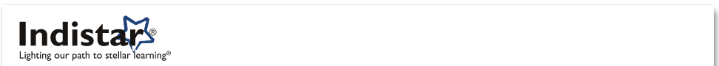

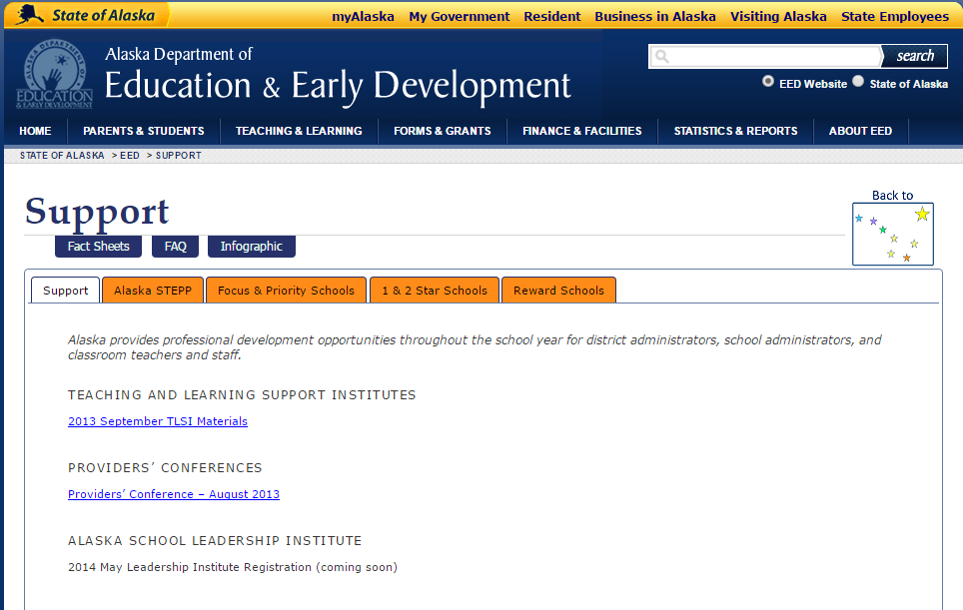
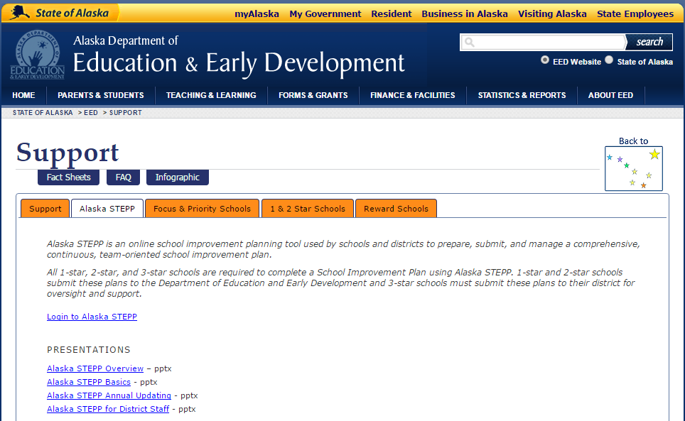

Logging into Alaska STEPP
Creator of STEPP
Obtain your username & login from your Process Manager
Notes:
The Process Manager at each school site will be given a Login Name and Password and will be able to log into the Indistar page from the EED homepage. Indistar is the company that created the School Improvement software and
Online resources
Upper left: is the Education and Early Development page accessed through Alaska’s main page
Upper right: Once “Support” is clicked it will take you to the upper right – click on the “Alaska STEPP” tab
Lower Left: you are now on the page accessing information regarding Alaska STEPP as well as the link to it.
Lower right : This is the main page of information and access to Indistar’s website as well as Alaska STEPP log in.
Alaska is part of their consortium and named their custom created program Alaska STEPP, i.e., Steps Toward Educational Progress & Partnership.

Slide 14
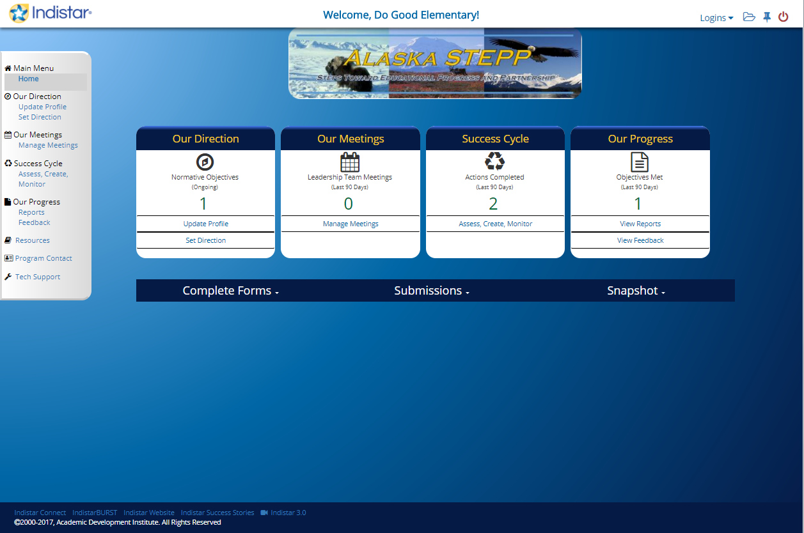
Looking at the Home Page
Better organized to access your familiar info:
1) Main Menu
2) Block Icons
3) Banner for forms
4) Upload folders
Notes:
For complete instructions and detailed directions access the Alaska STEPP User’s Manual: http://education.alaska.gov/aksupport/#c3gtabs-stepp

Slide 15
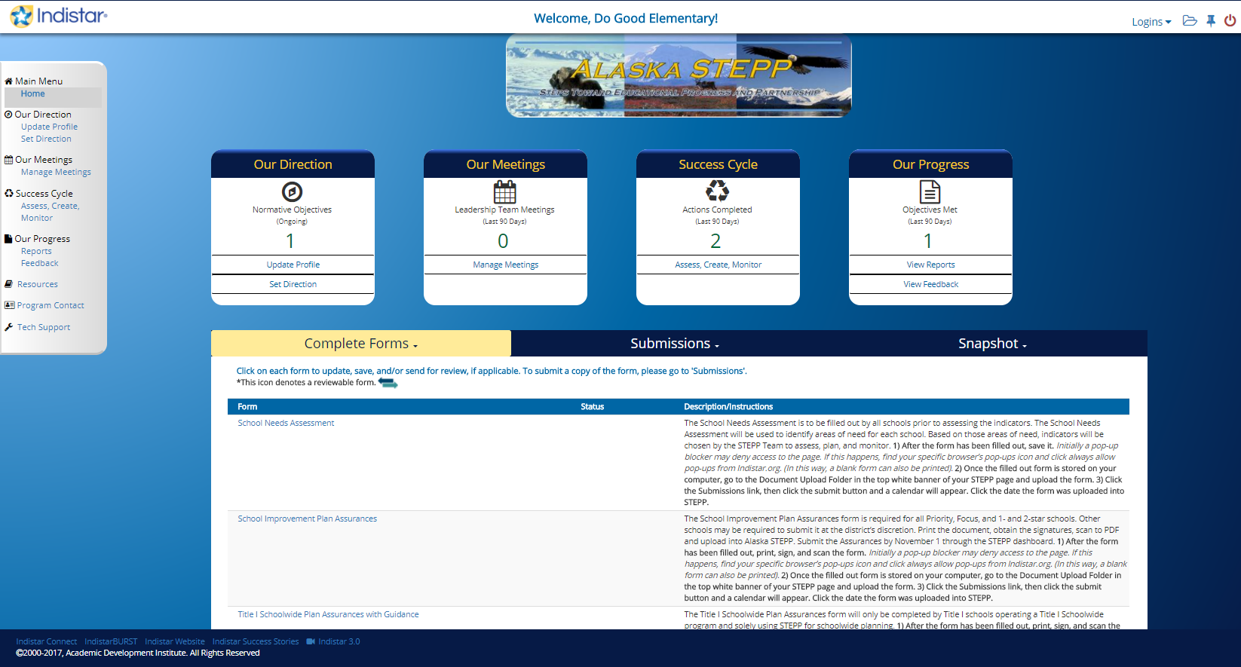
The Dashboard Complete Forms
Upload Folder
Forms to Complete & Upload
Notes:
For a complete explanation of the Dashboard tabs access the Alaska STEPP User’s Manual on the EED website: http://education.alaska.gov/aksupport/#c3gtabs-stepp

Slide 16
Review: Logging in & the Home Page
LOGGING IN
Go to the EED Homepage
Click on the orange Support Tab
  Click on Alaska STEPP
    Login to Alaska STEPP
      Click on Alaska STEPP
        Enter Login and Password
OR GO TO
http://www.Indistar.org
What is on the Home Page ??
Site name is noted in the top middle.
Gray main menu bar on the left
Four main icons in the center
Blue banner for forms
Upload folder and logoff icons in upper right hand corner

Slide 17
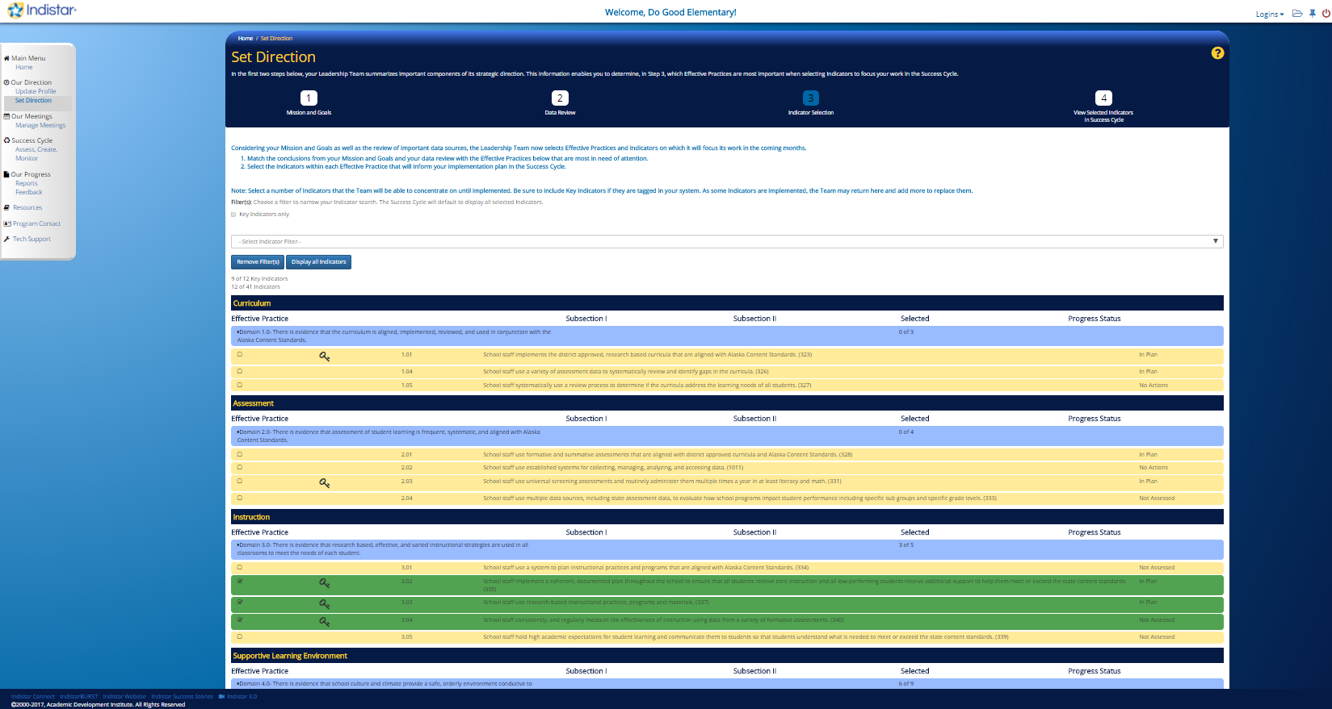
Our Direction and Selecting Indicators
icon “3” to check your selected indicators.
In “Our Direction”/”Set Direction”

Slide 18
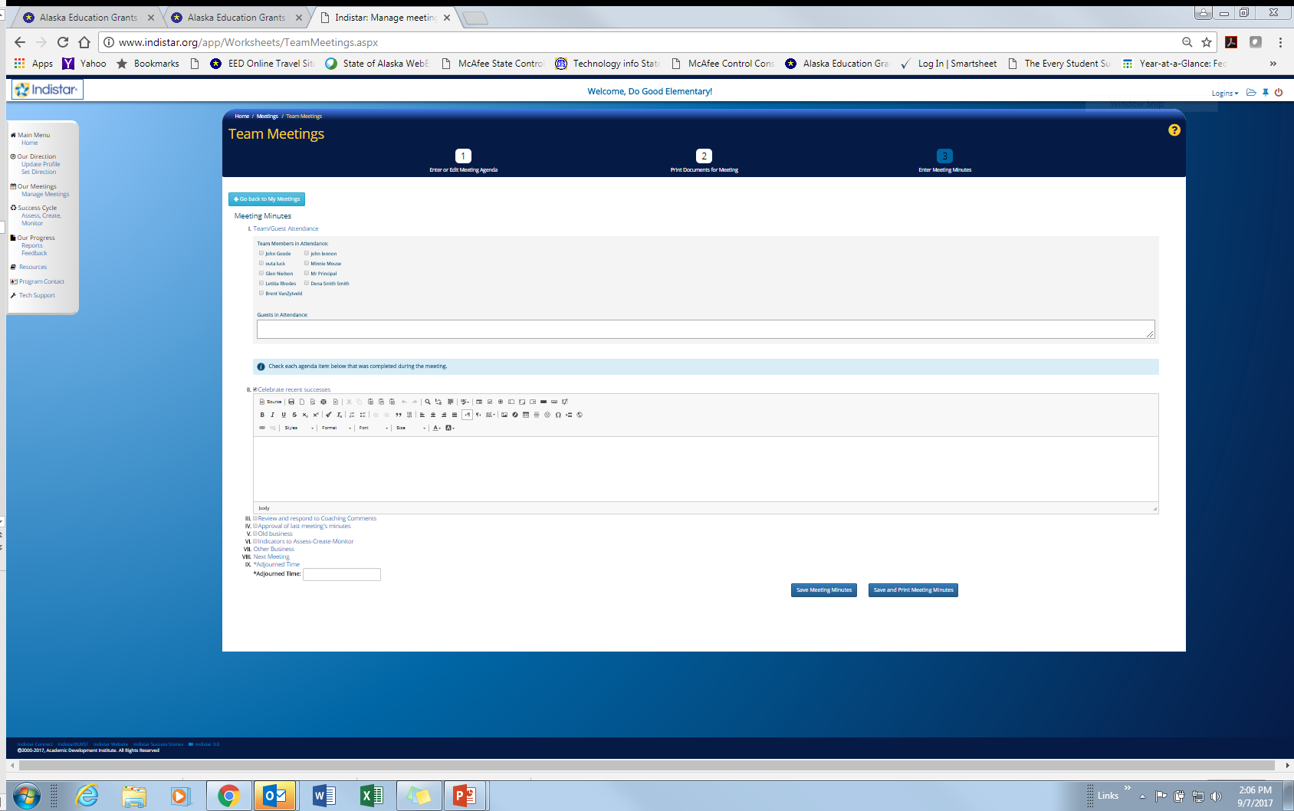
Our Meetings/ Manage Meetings
Our Meetings/Manage Meetings/Team Meetings number “3” to click on members and add content.
Cut and paste agendas or minutes into this field or other fields created when box is checked.
Notes:
Knowing how to go between the Main Menu Page and the Navigation Toolbar is helpful!

Slide 19
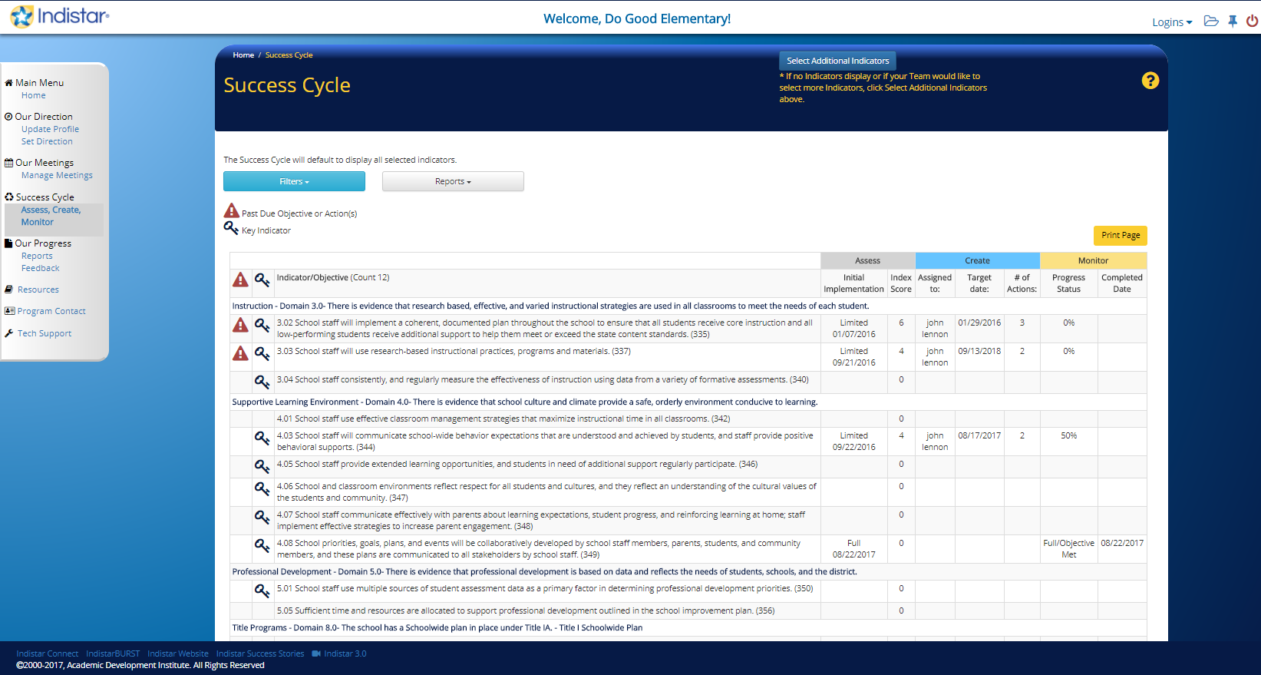
Success Cycle/ Assess, Create, Monitor
Main Work Page
Indicators listed have been selected in “Set Direction”
Add indicator by clicking “Select Additional Indictors”
Click on indicator to work with it
Notes:
The three processes of continuous school improvement planning (assess, create, and monitor), can be accessed using the Navigation Toolbar or the Main Menu Page icons. Using this feature enables the user to move back and forth between the three processes with ease.

Slide 20
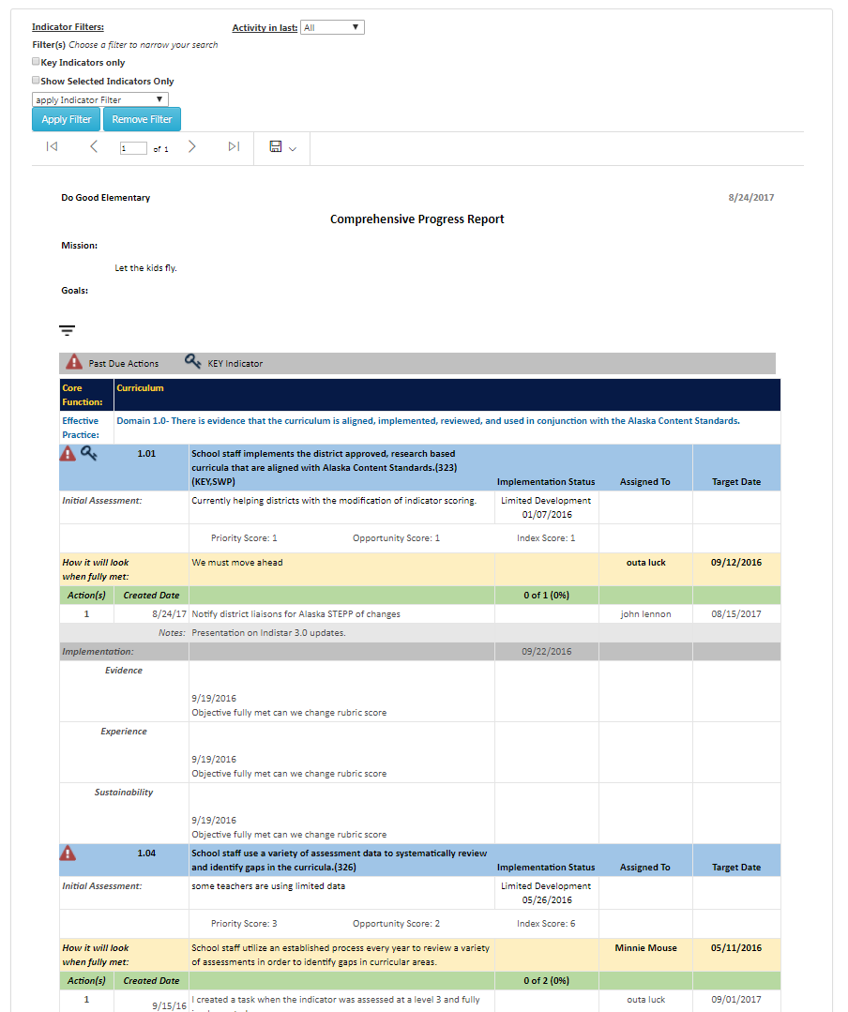
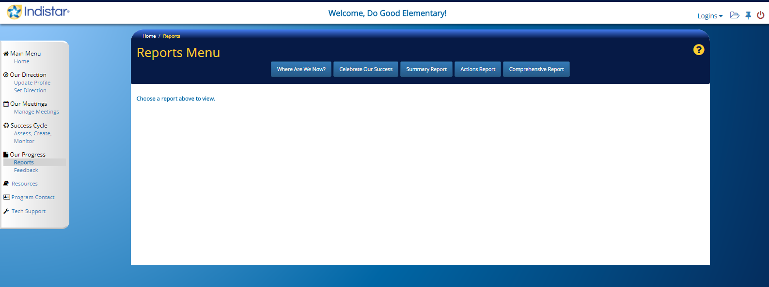
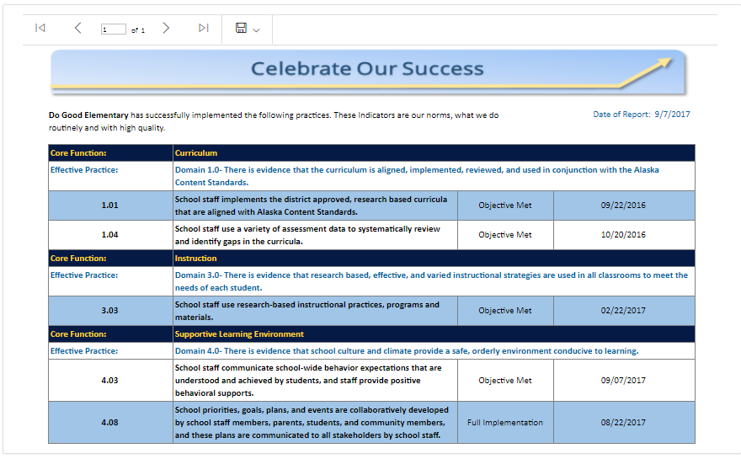
Our Progress
Access printable final reports and filterable reports that can all be used for websites or presentations.
Comprehensive report
Celebrate Our Success report
Notes:
Comprehensive report shown that is filterable for indicator status.

Slide 21

Alaska STEPP Search
Login to STEPP using
Login: ak - Password: ak.
With a partner, complete each item.
Go between Home page, Our Direction, and Success Cycle.
Add a person to the School Team.
Delete a person from the School Team.
Enter new school information.
Find and Upload the School Needs Assessment.
Assess an indicator.
Write an objective and add actions.
Monitor an indicator that has actions.
Create a new Meeting Agenda.
Generate a Comprehensive Plan Report.
Generate a Detailed Report of Assessed Indicators
Generate a List of Objectives Included in Plan
Notes:
Do NOT Assess an Indicator on your site’s account until your site’s Team has fully agreed on an assessment score. Once an Indicator is given a rubric score, it cannot be changed; the entire monitoring process must be completed once an indicator is given a score in the online tool.
Use the Alaska STEPP Search to learn about Alaska STEPP

Slide 22
Using Alaska STEPP With a Team
Schedule regular meetings and meet consistently with a specific purpose.
Use a pacing guide to update and monitor indicators.
Ask for input from all stakeholders.
Provide guest passwords for stakeholders.
Report out on successes regularly.
Predetermine celebration occasions when certain objectives are met.

Slide 23
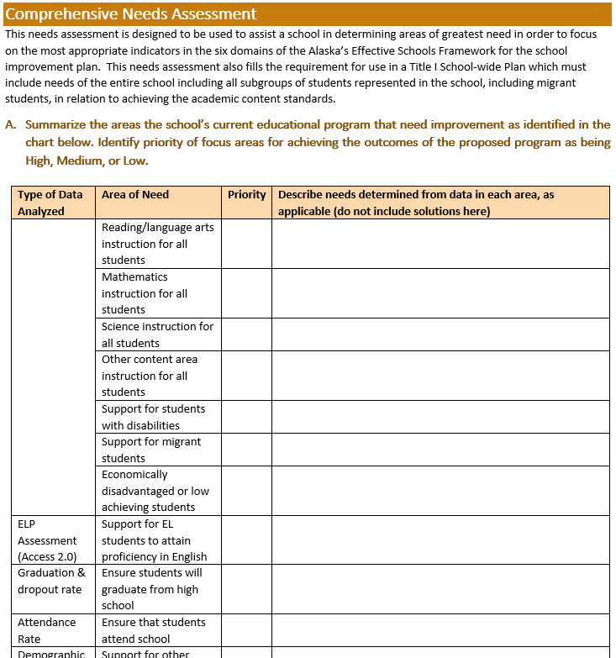
Filling out the Needs Assessment
Notes:
The ‘School Needs Assessment Form’ and Assessing the Indicators are two different processes.

Slide 24
School Needs Assessment
Needs Assessment form is located on the Home Page under the “Complete Forms”.
Analyze state assessment data and MAP/AIMSWeb/Diebels/AMP/Attendance/
Graduation Rate/Behavior/Perception data.
School wide goals for areas of need in reading, writing, and math are provided.
Analyze subgroup data.
Write specific goals if necessary.
Write a narrative summary of site’s strengths and weaknesses.

Slide 25
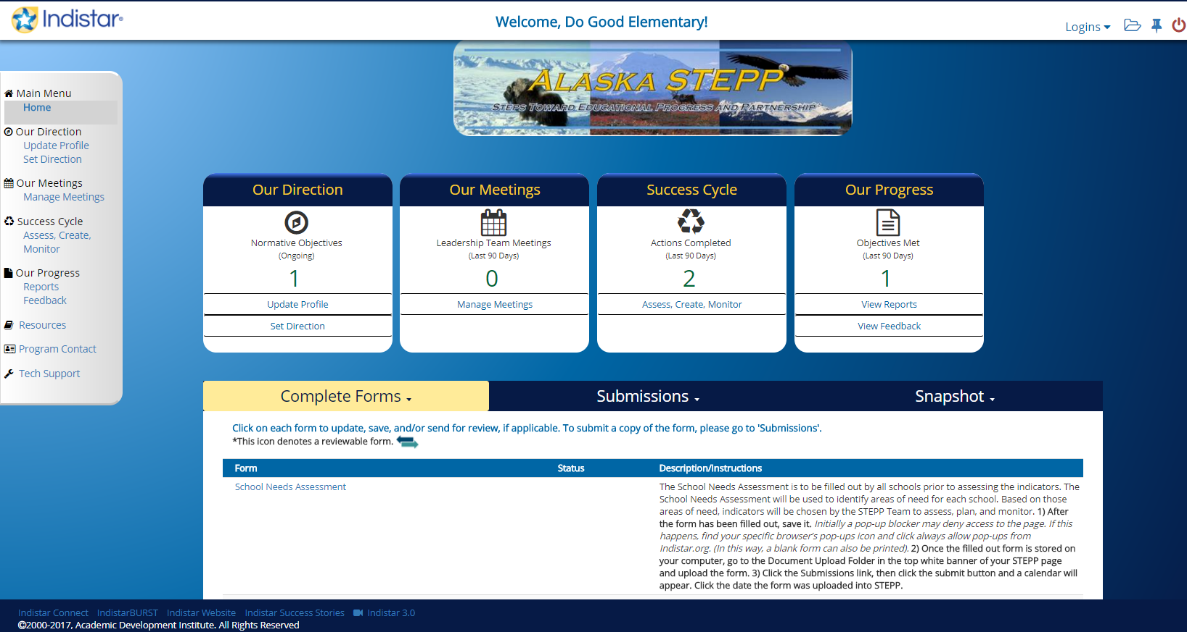
Where to Find the
School Needs Assessment Form
  Go to the Home page of your site’s STEPP account.
  Find the Complete Forms
  The Needs Assessment Form link will be visible.
  Fill the Report out, Save, Upload into the Document Upload Folder, and submit under the Submit Forms/Reports Tab.
Here

Slide 26

The intention of the Department of Education and Early Development is that schools will fill out the School Needs Assessment form after a data analysis session so they can get an accurate look at the areas of need in their schools.
This drives the continuous school improvement process.

Slide 27
How to Assess Indicators
  From the “Our Meetings” page, click “Set up a new Meeting Agenda”, click on “2” button in Team Meetings and click on “Assess worksheet”; print several copies of the Assess (blank) worksheet. There are also other worksheets here that can be printed.
  With your STEPP Team, using the Rubric & Worksheet, document what practices are currently being implemented at your site.
  Or, enter assessment information right into Alaska STEPP, the online tool.
Notes:
For complete instructions and detailed directions access the Alaska STEPP User’s Manual: http://education.alaska.gov/aksupport/#c3gtabs-stepp

Slide 28
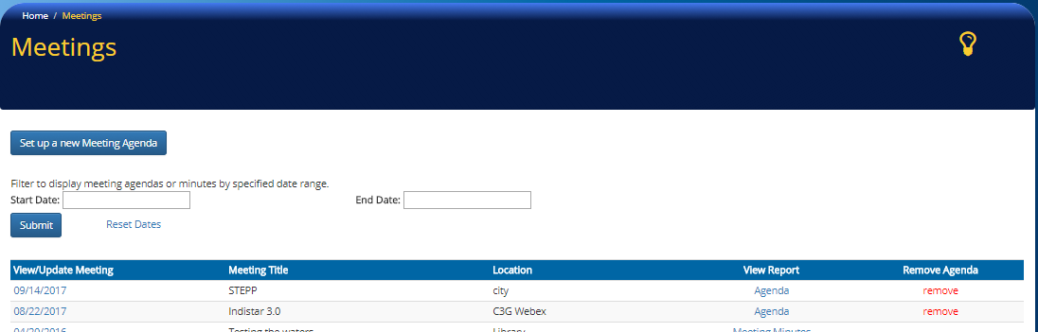
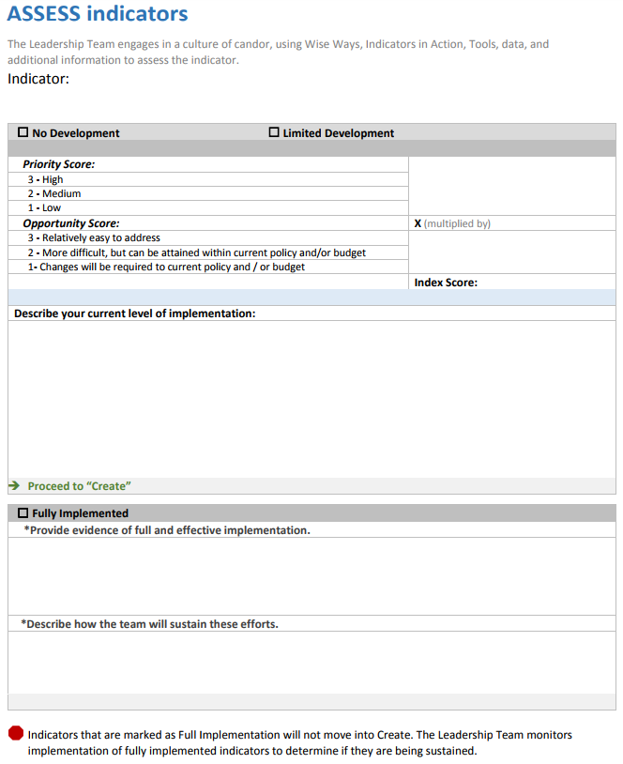
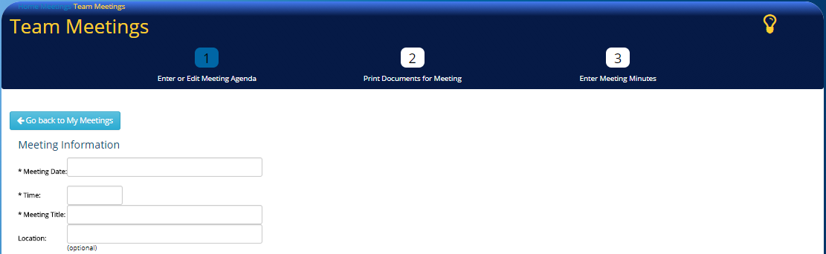
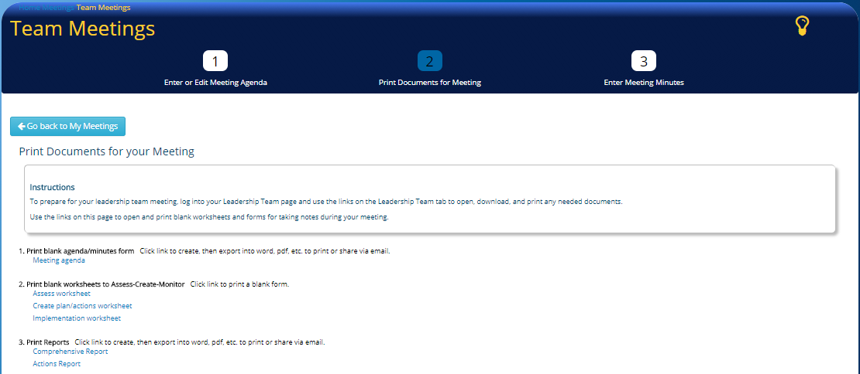
Assessing Indicators Worksheet
1
2
3

Slide 29
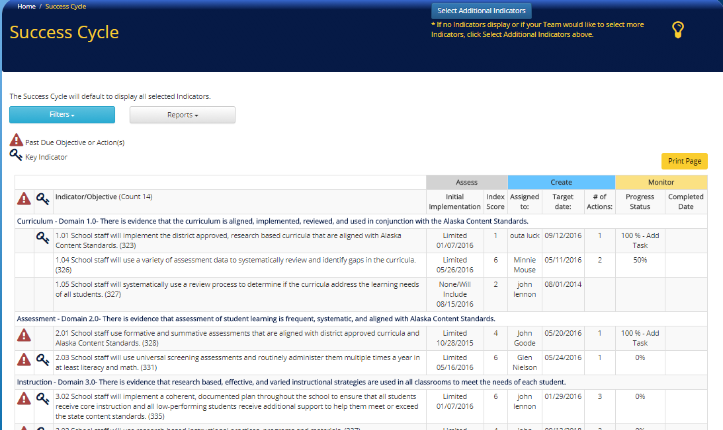
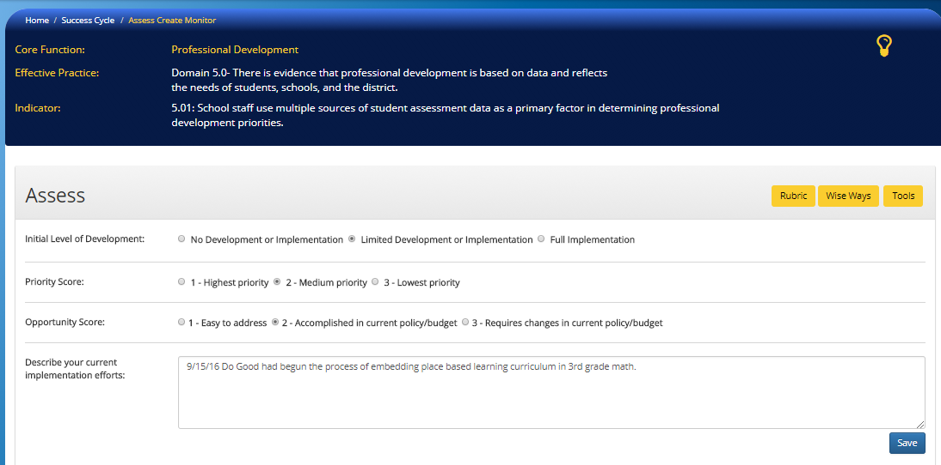
Assessing Indicators Online
Choose an Indicator
Click Here
Enter the score and describe why that number was chosen.
Notes:
Assessing an Indicator inside the Success Cycle and Assess Create Monitor
Choose an indicator
Click on Success Cycle choose an indicator already available (skip to step 2)
Select a different indicator from Set Direction by
Clicking on “3” button, clicking on the Domain and clicking the selection box marking with a check.
Then clicking on the “4” button to go back to the Success cycle.
Items to print out once the indicator has been selected
Click on the “Rubric”(yellow button) for explanations regarding definitions of buttons and number selections.
Click on the “Wise Ways” (yellow button) to look at some background information targeting this indicator. Print out the wise ways for your team.
Click on the Boolean button to assess the initial development of the indicator.
Click on the bubble for priority score
Click on the bubble for opportunity score
Describe the current implementation efforts (start with a date)
Click Save

Slide 30
How to Create a Plan:
Write Objectives and Add Tasks
In your site’s STEPP account, “Our Meetings” page, click “Set up a new Meeting Agenda”, click on “2” button in Team Meetings and click on “Create plan”; print several copies of the Plan (blank) worksheet.
  With your STEPP Team, using the Rubric & Worksheet, write objectives and add tasks.
  Enter the data from the Assess & Plan Worksheets into STEPP and begin Monitoring your site’s progress.
Notes:
For complete instructions and detailed directions access the Alaska STEPP User’s Manual: http://education.alaska.gov/aksupport/#c3gtabs-stepp

Slide 31
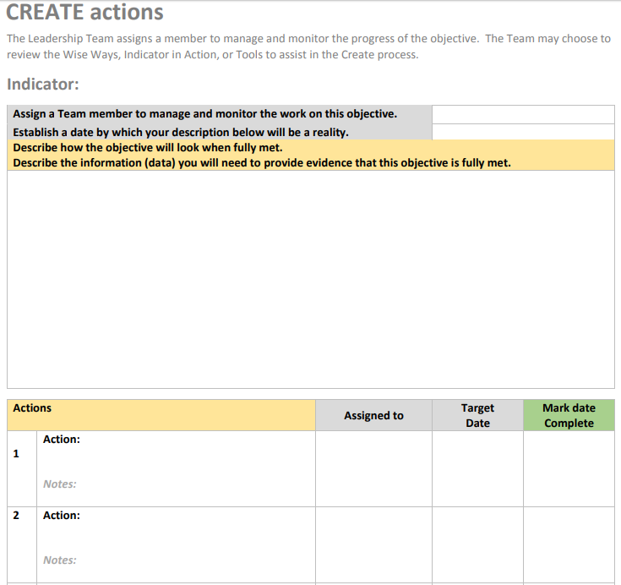
Create a Plan by Writing Objectives and Adding Actions using the Planning Worksheet
1
2
3

Slide 32
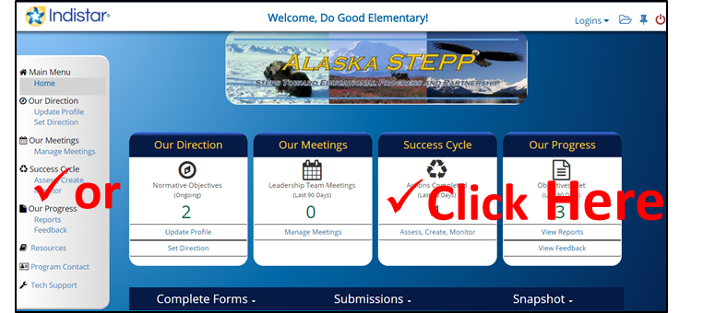
Success Cycle
Assess, Create, Monitor
The Success Cycle Page can be accessed from the home page through
  One of the four main icons
  The gray menu bar on the left.
Make comments and track progress.
Notes:
For complete instructions and detailed directions access the Alaska STEPP User’s Manual: http://education.alaska.gov/aksupport/#c3gtabs-stepp

Slide 33
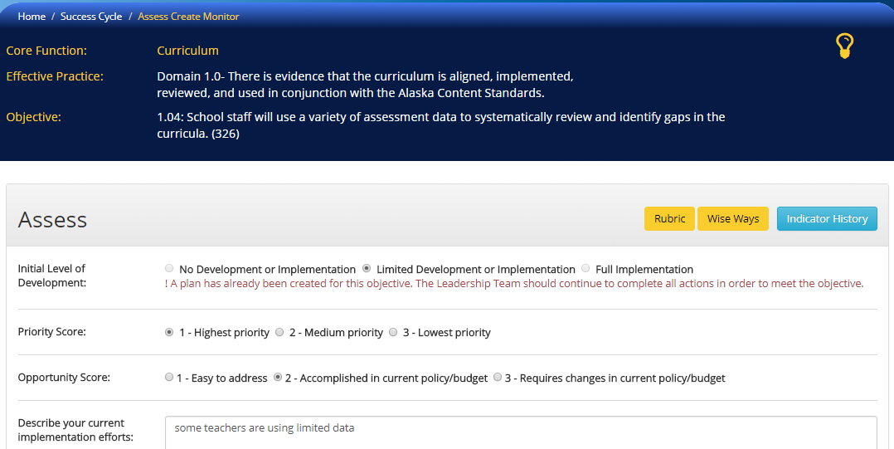
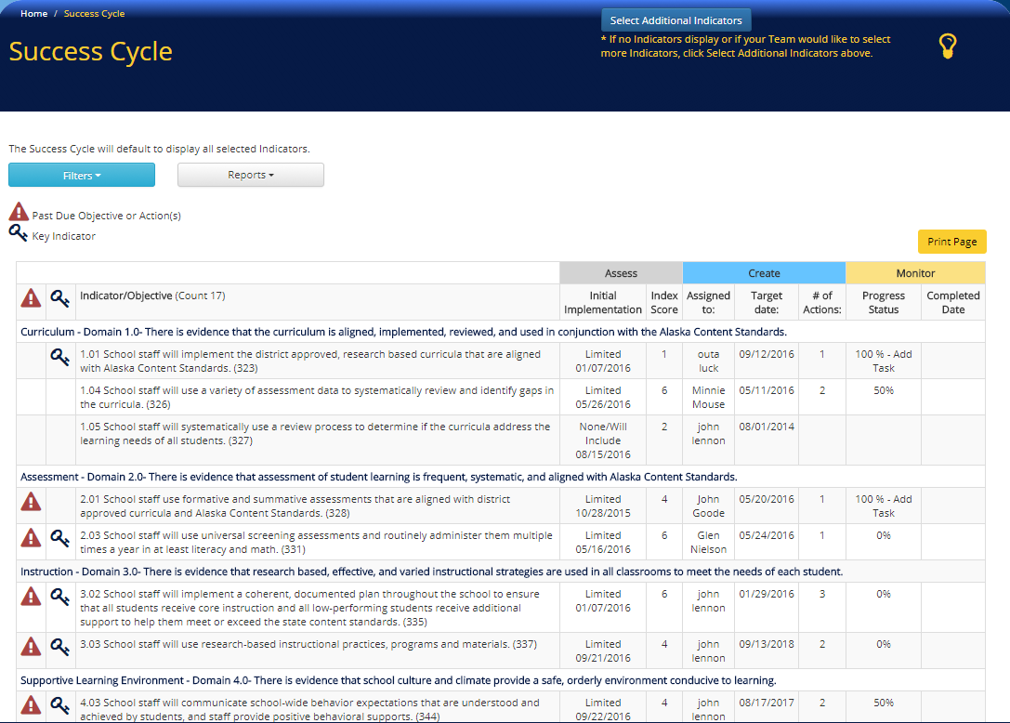
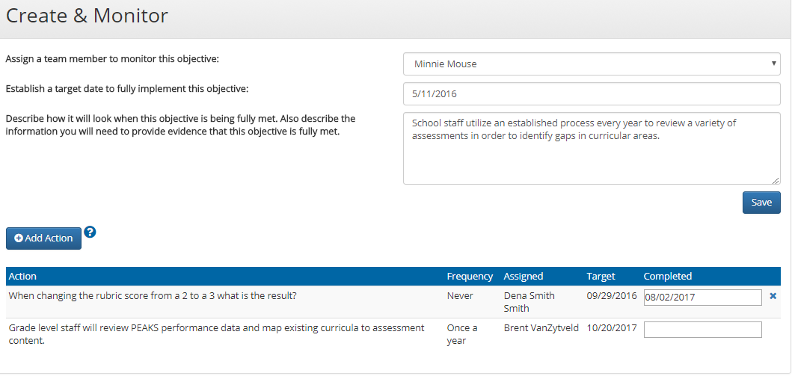
Creating a Plan: Writing Objectives and Adding Tasks Online
Assess the indicator
Click an indicator
Write an Objective
Add an Action
Notes:
It’s all on one page found on the Success Cycle page.
The Success Cycle Page can be accessed from the home page through
one of the four main icons
the gray menu bar on the left
For complete instructions and detailed directions access the Alaska STEPP User’s Manual: http://education.alaska.gov/aksupport/#c3gtabs-stepp

Slide 34
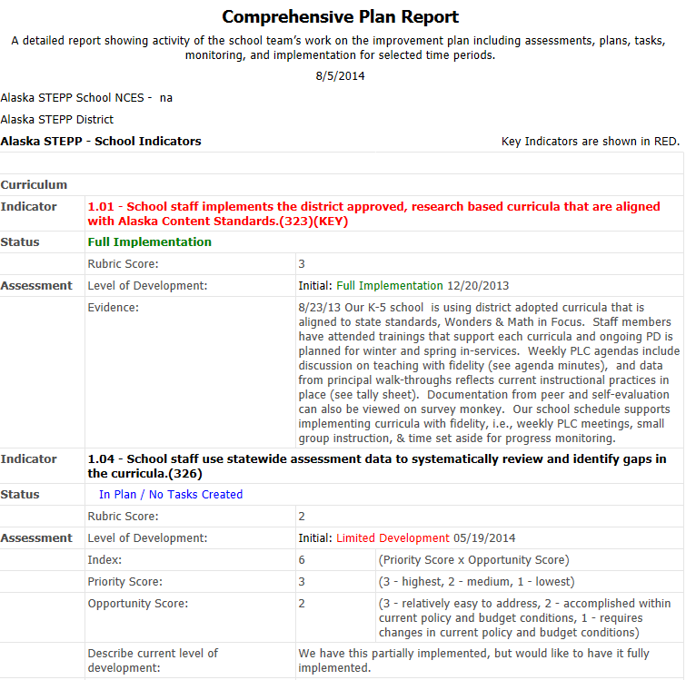
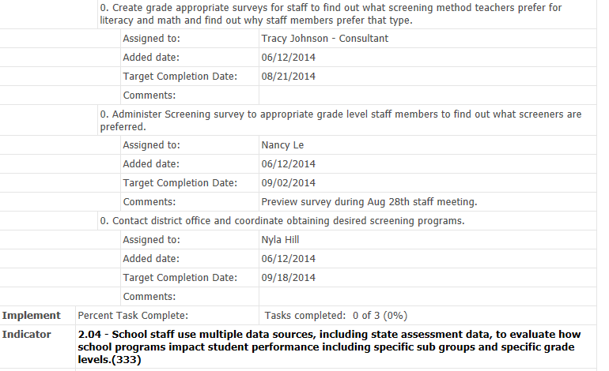
Comprehensive Plan Report
Notes:
The Comprehensive Plan Report is the School Improvement Plan and is submitted on November 1st of each year using the Submit Forms/Reports tab on the Dashboard.

Slide 35

Using Alaska STEPP is a Process
Teams monitor the implementation of their plan over the course of the year.
The plan is never finished and teams continuously assess,
plan, and monitor.
Notes:
Plans are dangerous- they are only useful if you implement them
Alaska STEPP does not ensure action, but it does have a structure that is designed to help instructional leaders keep track of the implementation efforts and hold themselves and their teams accountable

Slide 36
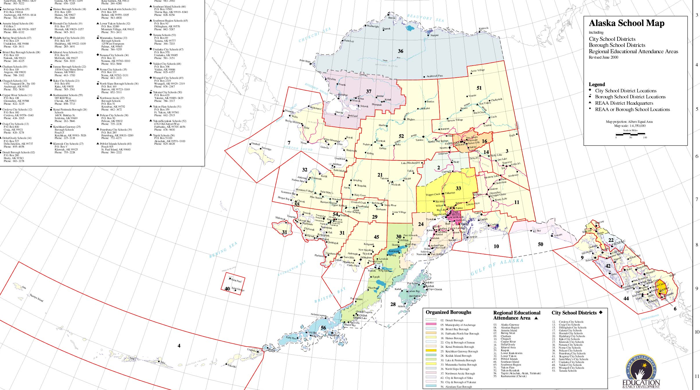
Alaska STEPP is Adaptable
It is designed to be flexible in order to meet the individual needs of Alaska’s diverse schools and districts.
Notes:
Flexible in the following ways:
Sites determine the pacing guide
Sites determine where to put the focus
Sites determine the time line of the plans to match the reality of your school
Sites write their own objectives

Slide 37

Improvement Planning Using
Alaska STEPP is a Team Driven Process
Notes:
This process relies on a team- it is not a plan to be written by one person.
Change requires collective capacity or disciplined collaboration. Shared responsibility and shared ownership of everyone working toward the same goal
Clear purpose is widely shared
Priorities on improving instruction
Providing support: pd, resources, flexibility

Slide 38

Alaska STEPP is:
Continuous
Comprehensive
Team-oriented
However…. STEPP is not a Magic Bullet!!!
Notes:
Never Done.

Slide 39

Notes:
It is a tool. It is not a quick fix. This will take you a year, or possibly three years for some goals.

Slide 40
First Steps
School STEPP teams are formed and have regular meetings scheduled.
Complete a Data Analysis & Needs Assessment.
Make sure the chosen indicators meet the requirements of school improvement and Title I.
Make sure the objectives and tasks created get your school from where you are, to where you want to go. Are the tasks realistic? Is the timeline for completion realistic?
Schedule at least one meeting per month for the entire school year using an Annual Pacing Guide.

Slide 41





Yearly Flow of Work for Schools
Form Team
Monitor
Assess
Implement
Create Plan
Notes:
Nonlinear view

Slide 42

For additional
information about
Alaska STEPP
Contact:
Scot Fiscus
e. scot.fiscus@alaska.gov
p. 907-465-8718

