Slide 1
Fresh Fruit and Vegetable
August 2015

Slide 2
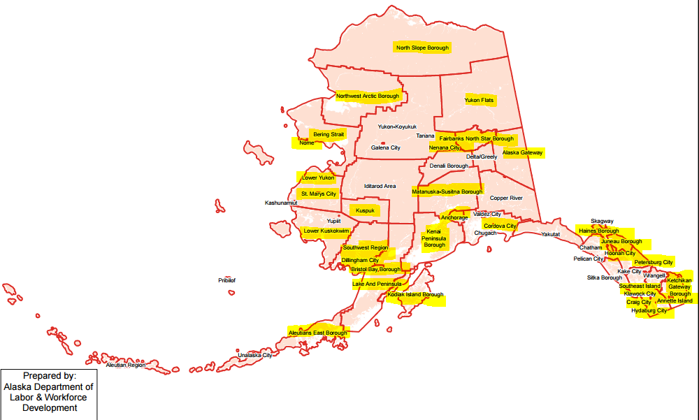
Notes:
This is Alaska’s 8th year participating in FFVP
For the 15/16 school year, we have 199 sites in 31 districts across the state

Slide 3
School Selection
Participate in NSLP
Elementary school (or K-8, as applicable)
High percentage of free and reduced price students
Agree to program service rules
Notes:
FFVP is a federally funded grant program that provides all children in participating schools with a free fresh fruit or vegetable snack during the school day. It operates as a reimbursement model. Since many of your are returning sponsors you know that you already meet the basic eligibility requirements that you are an elementary (or K-8) schools participating (and in good standing) in the National School Lunch Program with a high percentage of free and reduced price students.
We do currently have a very small amount of unallocated funding for the 2015-2016 school year that may allow us to bring on additional sites for the second quarter of the grant that begins October 1st. After we receive the 1st quarter allocation from USDA and allocate grant awards, we will be doing targeted outreach to the next eligible program. I have a spreadsheet of all our eligible sites ranked in order of free and reduced price student percentage, and right now it has a cutoff line (mid-40’s) for how many programs are funded….if we have enough additional funds to solicit additional participation I’ll look at the next eligible school, call you and ask if you want to participate. Lack of timely response will be cause to move on as we want to get the maximum number of programs running.

Slide 4
Grant Awards
Per student allocation
1st Quarter: July-September 2015
2nd Quarter: October 2015-June 2016
Unspent funds are returned to USDA
Notes:
We have already issued initial award letters for the 15/16 school year. Total grant awards are calculated based on a per student allocation between $50 and $75. This funding is issued in two separate awards: the 1st quarter funding July-September, and the second quarter funding October-June. Please keep in mind that unspent funds are returned to USDA (which is something we do not like to do). Underspending funds will likely lead to a decrease in your per-student allocation the following year…for example going from $60/student to $55/student.
For the 14/15 school year, we had 4 of 35 sponsors fully expend their grant award, and 22 of 35 (or about 63%) of sponsors expend 90% or more of their grant award.

Slide 5
Allowable Costs
Operating
Fresh fruits and vegetables
Non-food items
napkins, paper plates, serving bowls and trays, trash bags
Labor costs
Including salaries and fringe benefits
Notes:
So, you’re issued a grant award….what can you spend this money on? FFVP expenditures are broken out into two categories: operating costs and administrative costs. Operating costs will be the bulk of your expenditures. This includes fruits and vegetables, non-food items related to service, and labor costs

Slide 6
Administrative Costs
Indirect labor
Equipment purchases
Must be pre-approved by CNP!
Limited to 10% of grant award
Notes:
The other category of FFVP expenditures is your administrative costs. This includes indirect labor costs, such as salaries for employees who manage paperwork, compile claims, or handle other administrative processes. Administrative costs also cover equipment purchases such as coolers, portable kiosks, or food carts. Please note that all equipment purchases must be pre-approved by CNP.
Administrative costs are limited to 10% of your total FFVP budget and this is tracked, so please plan accordingly.

Slide 7
Spending Plan
Helps ensure funding lasts all year
Helps document carryover between grant periods
Must be documented on your spending plan
NOT an automatic rollover
Due Friday, August 14th
Notes:
On the topic of budgets, you are required to submit a spending plan detailing your monthly anticipated monthly expenditures for both the 1st and 2nd quarter of the grant. This helps you to plan costs while accounting for school breaks, and also helps document carry-over between the two grant periods. “Carry over funding” means that funds from the 1st quarter will be used (obligated) to forward-purchase produce for delivery in October or November. 1st Quarter funding is not automatically rolled over for use after September 30th. You must obligate the funds before September 30th and send the documentation to our office to confirm the order was obligated before the deadline. The September claim must be revised in CNPWeb to receive reimbursement once items are delivered and paid for. There is a deadline for the September claim revisions, which is 12/15/15.
Spending plans are due to me by Friday, August 14th.

Slide 8
Service Rules
Fresh fruits and vegetables
Easily identifiable
Dips for vegetables only
Low fat or non-fat
“Prepared” vegetables
Outside of NSLP and SBP serving times
Notes:
Now that you’ve received funding and purchased your produce, it is important to keep in mind the service rules of the program. The fruits and vegetables that you serve should be easily identifiable to your students. Produce should be recognizable in it’s natural state, although this doesn’t mean it must always be served whole, slicing into smaller pieces for each of service is acceptable.
Dips, such as ranch, are allowed to be served with vegetables only and must be low-fat or non-fat. The amount of dip should be the same as a common serving size for a condiment, 1-2 tablespoons.
Serving cooked vegetables is an option….must start with a fresh product (not frozen or canned), must be an item that is not normally consumed raw, and must be accompanied by a nutrition education lesson. This type of service is limited to once per week.

Slide 9
Q & A: What about zucchini muffins? Or smoothies?
Processed/preserved produce
Snack type fruit products
Trail mix
Fruit or vegetable pizzas
Fruit or vegetable juice
Jellied fruit
Notes:
These are questions that tend to come up at least once during the school year….if we can serve cooked vegetables, can we cook zucchini into muffins? **Who knows the answer**….and why not?
The produce must remain identifiable and be served in it’s natural state. This same rule applies to smoothies. Other items that are not allowable for service include….

Slide 10
Q & A: Can we continue the pilot program?
Canned/Frozen/Dried pilot during the 14/15 school year
Still being evaluated
Until we receive official determination, these products are not allowable in the 15/16 school year

Slide 11
Participation
Available to all eligible students
Teachers responsible for serving
Enrolled pre-schoolers
Not available for general adult population in the school
Notes:
FFVP service must be available free of charge to all eligible students in your building (all student if K-8; no high schoolers if K-12). If the school has a preschool or head start program and those children are enrolled in the school, they can participate.
Teacher responsible for the service of the snack are allowed to participate, this is actually encouraged as teachers play a valuable role in modeling positive eating habits by consuming fruits and vegetables with their students. Participating teachers are strongly encouraged to include a nutrition education message, even if it is brief.
Fruit and vegetables are not intended to be available for the general adult population in the school, visiting adults or community members, etc.

Slide 12
Q & A: What about our high schoolers?
District can choose to subsidize participation
Must keep clear documentation of separation of costs
Notes:
This is a common question, especially for those of you operating K-12 sites. FFVP regulations do not permit expenditures of funds for highschoolers, but what can you do about that…..
We have some districts that supplement the cost of providing snack for their students in grades 9-12 to ensure that the whole school community receives snack. Be sure to keep clear documentation of the separation of costs.

Slide 13
Program Goals
Healthier school environments
Increase exposure
Serve a wide variety
Impact dietary choices
Notes:
As you are getting ready to plan your year, it is important to keep in mind the program goals in addition to the regulatory requirements. The overarching goal that we are working toward is creating healthier school environments. With this program we do that through expanding the variety of fruits and vegetables students are exposed to, and hoping that this exposure will increase consumption, ultimately guiding the dietary choices made by students to impact their present and future health.
This program is really seen as a catalyst for change in efforts to combat childhood obesity by helping children learn more healthful eating habits.
That being said, if we are staying true to these goals and really trying to increase variety and exposure for our students, that is up to the people in this room managing the program and placing orders to make that happen.

Slide 14
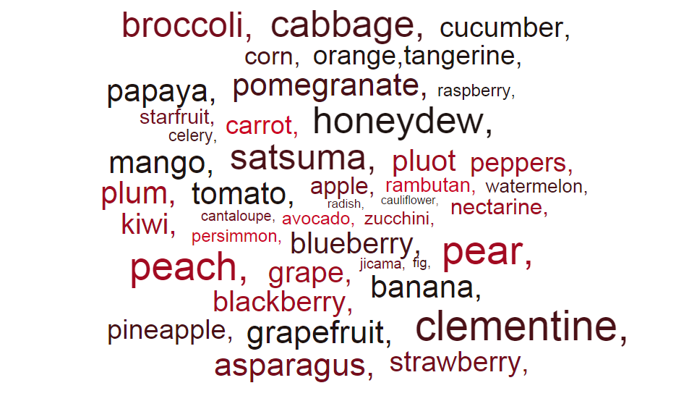
Alaska Highlights
51 different items
28 different fruits
23 vegetable items
Notes:
On that note, I’d like to highlight a few things we saw happening in the program around the state during the 14/15 school year. This data was collected from the itemized reimbursement forms that were submitted with your claims last year, and it is ‘relatively’ comprehensive, not exact.
We had districts that served:
51 of total items
28 different fruit items
23 vegetable items
5 districts that served NO vegetables…an additional 6 districts that only served one vegetable (any guesses on most popular veggie? Carrots)
Due to the geographic remoteness of many of our schools, there are unique ordering and shipping challenges for some of our programs. Think about expanding variety however you can. If you are only ordering apples or oranges, really make an effort to serve different varieties. Some districts served 7 varieties of apples.

Slide 15
Claiming for Reimbursement
Notes:
You’ll submit FFVP reimbursement request with your NSLP claim in CNPWeb. FFVP claims follow the same rules as NSLP claims and must be submitted within 60 days. You must also fill out and submit the FFVP itemized reimbursement report in order for your FFVP request to be processed. If you do not submit this document, we will hold your claim.

Slide 16
Administrative Review
Claim validation by CNP
Supporting documentation required
Claim supports allowable costs including:
Minimal labor and non-food costs
Equipment purchases are pro-rated
No more than 10% administrative
Notes:
If you are scheduled for an administrative review this year, your FFVP operations will be included in that review. This process includes an off-site claim validation as well as an on-site operations review. First we will talk about the claim validation. CNP will validate a claim for one month of FFVP operation. This will require the district to submit all back-up documentation (receipts, POs, etc) for the claim. We will validate the documentation for allowable costs against the total amount claimed for reimbursement. During this process, we are looking to see that the majority of funding is going toward the purchase of fruits and vegetables, labor and non-food costs are minimal, equipment purchases are prorated (if applicable), and no more than 10% of funding is going to administrative costs.
This process does carry the potential for fiscal action. CNP must disallow any portion of a claim for reimbursement and recover payment for any unallowable costs.

Slide 17
On-Site Operations
Available for free to all enrolled and eligible students
Service is outside NSLP and SBP mealtimes
Program is publicized in the school
No frozen, canned, dried, processed, or other unallowable products
Notes:
While CNP staff or contractors are on-site for the administrative review, we will be looking to see that the program is operated in accordance with the regulations we’ve talked about during this presentation, including:

Slide 18
On-Site Operations
Low fat or fat free dips, for vegetables only
Does not provide snack to ineligible adults
Cooked vegetables no more than once per week, with nutrition education
Follows HACCP principals, sanitation, and health standards
Notes:
A few other criteria we will evaluate are:
If during either the off-site claim validation or the on-site observation we discover issues of non-compliance, corrective action will be issued to remedy the problem. CNP has the right to suspend or terminate programs for repeated failure to meet program requirements.

Slide 19
Training Resources
Webpage
Handbook
Monthly bulletins
eLearning

