Slide 1
Alaska English/Language Arts Standards
Notes:
Welcome to an Introduction to the Alaska English/Language Arts & Mathematics Standards.

Slide 2
Objectives
Highlight shifts in Alaska English/Language Arts Standards by Content Area

Slide 3
Highlights In Reading
Information and literature
Text dependent questions and answers
Complex Text
Foundational Skills for K-5
Notes:
There are standards in the focus area of informational and literary text. Text dependent question and answers are large part of the standards and there is an increase in the level of text complexity and the fact that Foundational skill standards are only stated in Kindergarten thru grade 5.

Slide 4
Informational and Literary Text

Slide 5
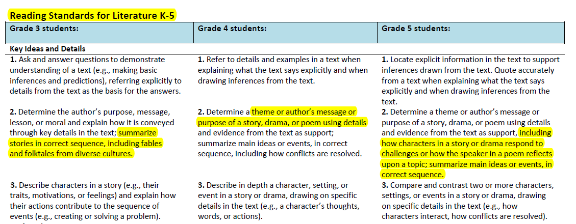
pg 8
Notes:
The first highlight in the reading content area is that there are standards for Literature and standards for informational text. First let’s look at Literary text standards. The students are asked to analyze and summarize expectations specifically relevant to literature.

Slide 6
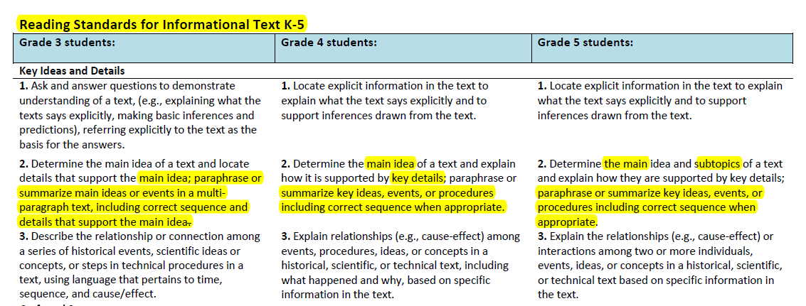
pg 12
Notes:
Here is the same standard in the same grade level of the informational text Focus Area.
It is still tied to Anchor Standards number 2, but is relevant to informational text.

Slide 7
Example of Grade-Level Progression in Reading
Reading Standard 3: Analyze how and why individuals, events, and ideas develop and interact over the course of a text.
Reading Standards for Literary Text
Grade 7: Analyze how particular elements of a story or drama interact (e.g., how setting shapes the characters or plot).
Grade 9-10: Analyze how complex characters (e.g., those with multiple or conflicting motivations) develop over the course of a text, interact with other characters, and advance the plot or develop the theme.
Reading Standards for Informational Text
Grade 3: Describe the relationship or connection among a series of historical events, scientific ideas or concepts, or steps in technical procedures in a text, using language that pertains to time, sequence, and cause/effect.
Grade 7: Analyze the interactions between individuals, events, and ideas presented in a text (e.g., how ideas influence individuals or events, or how individuals influence ideas or events).
Grade 9-10: Analyze how the author unfolds an analysis or series of ideas or events, including the order in which the points are made, how they are introduced and developed, and the connections that are drawn between them.
Grade3: Describe characters in a story (e.g., their traits, motivations, or feelings) and explain how their actions contribute to the sequence of events (e.g., creating or solving a problem).
Notes:
Here is a side by side comparison between the standards for literary and informational text across the grade spans.
This is Reading Anchor standard #3 for Literary text and Informational text. You can see how students would be expected to be able to analyze and synthesis both types of text. However, the outcome of that analyzes is more specific to text type.

Slide 8
http://teachertube.com/viewVideo.php?video_id=250725&title=The_Balance_of_Informational_and_Literary_Texts_in_K_5

Slide 9
Text Dependent Questions and Answers

Slide 10
Notes:
Now let’s move on to another highlight in the Reading standards.
The expectation that the text is the centerpiece of questions and answers.
A student be able to extract from the text WHY they believe their answer to be correct. Questions like where in the text did you find that? Where do you think the author was saying that?

Slide 11
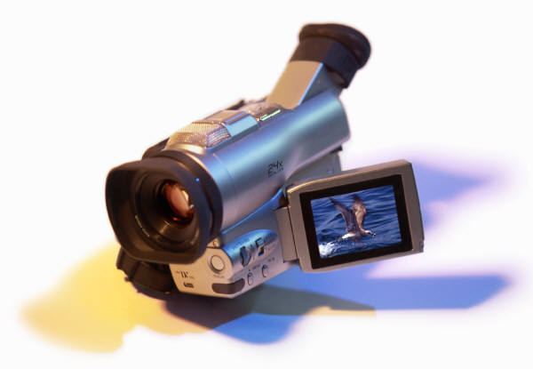
Video
http://engageny.org/resource/common-core-in-ela-literacy-shift-4-text-based-answers/

Slide 12
Complex Text

Slide 13
Notes:
Now let’s move on to another highlight in the Reading standards. There is an increase in the complexity of text the students are being expected to read. This difference is addressed in Standard #10.
What am I talking about when I say “increased complexity of text’?

Slide 14
Text complexity is defined by
w of Text Complexity
Notes:
Text complexity. In the past, when we looked at a text for complexity we primarily just looked at the quantitative measure, which deals exclusively with length and number of words. The more rigorous standard considers a qualitative measure which address the levels of meaning, structure, language conventionality and clarity. Reader and task considerations is another area that is considered in the more rigorous standards. This looks at the background knowledge of reader, motivation and interest. For instance, Steinbeck’s Grapes of Wrath may be considered at the second grade level when only looking at the quantitative measure but when the language conventions and needed for background knowledge of the reader are considered, it is a ninth grade level.

Slide 15
Text complexity is defined by
w of Text Complexity
Quantitative measures – readability and other scores of text complexity often best measured by computer software.
Quantitative
Notes:
In the past, when we looked at a text for complexity we primarily just looked at the quantitative measure, which deals exclusively with length and number of words. The more rigorous standard considers a qualitative measure which address the levels of meaning, structure, language conventionality and clarity. Reader and task considerations is another area that is considered in the more rigorous standards. This looks at the background knowledge of reader, motivation and interest. For instance, Steinbeck’s Grapes of Wrath may be considered at the second grade level when only looking at the quantitative measure but when the language conventions and needed for background knowledge of the reader are considered, it is a ninth grade level.

Slide 16
Text complexity is defined by
w of Text Complexity
Quantitative measures – readability and other scores of text complexity often best measured by computer software.
Qualitative measures – levels of meaning, structure, language conventionality and clarity, and knowledge demands often best measured by an attentive human reader.
Qualitative
Quantitative
Notes:
In the past, when we looked at a text for complexity we primarily just looked at the quantitative measure, which deals exclusively with length and number of words. The more rigorous standard considers a qualitative measure which address the levels of meaning, structure, language conventionality and clarity. Reader and task considerations is another area that is considered in the more rigorous standards. This looks at the background knowledge of reader, motivation and interest. For instance, Steinbeck’s Grapes of Wrath may be considered at the second grade level when only looking at the quantitative measure but when the language conventions and needed for background knowledge of the reader are considered, it is a ninth grade level.

Slide 17
Text complexity is defined by
w of Text Complexity
Quantitative measures – readability and other scores of text complexity often best measured by computer software.
Qualitative measures – levels of meaning, structure, language conventionality and clarity, and knowledge demands often best measured by an attentive human reader.
Qualitative
Quantitative
Reader and Task considerations – background knowledge of reader, motivation, interests, and complexity generated by tasks assigned often best made by educators employing their professional judgment.
Reader and Task
Notes:
In the past, when we looked at a text for complexity we primarily just looked at the quantitative measure, which deals exclusively with length and number of words. The more rigorous standard considers a qualitative measure which address the levels of meaning, structure, language conventionality and clarity. Reader and task considerations is another area that is measured in the more rigorous standards. This looks at the background knowledge of reader, motivation and interest. For instance, Steinbeck’s Grapes of Wrath may be considered at the second grade level when only looking at the quantitative measure but when the language conventions and needed for background knowledge of the reader are considered, it is a ninth grade level.

Slide 18
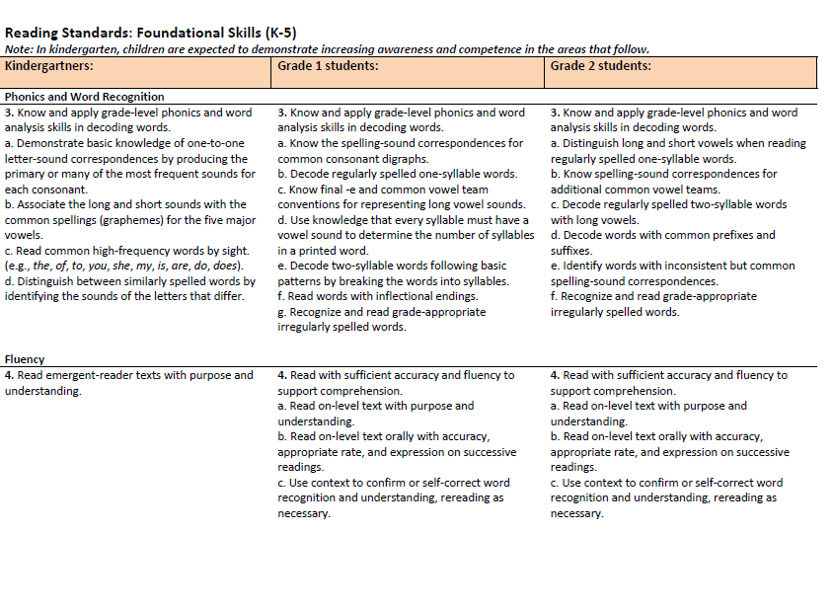
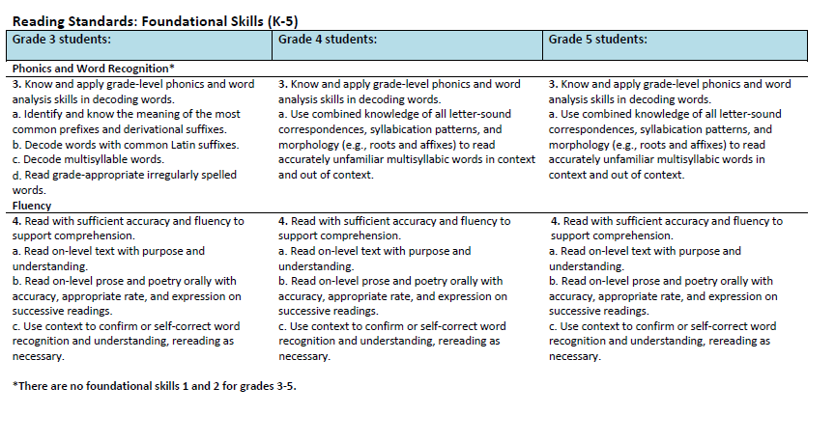
Notes:
One other point I would like to highlight in the Reading Content Area is that of the Foundational Skills Standards. It is in these foundational skills standards that the emphasis of instruction on the five components of effective reading instruction is found.
Students are expected to meet standards in the areas of phonemic awareness, phonics, vocabulary, comprehension and fluency. These standards are found in grade K-5. This is not because they should be ignored in the upper grades, but expectation is that by 5th grade the students should have a certain level of mastery in these foundational skills and need only occasional reinforcement.
Now let’s look +at the standards for writing.

Slide 19
Watch-
http://mediasite.k12.hi.us/HIDOE/Viewer/?peid=1d2454866ec44a769623b25c287efe691d

Slide 20
Highlights in Writing
Research and technology
Writing and reading standards are linked
Opinion writing in early grades
Notes:
In the writing content area of the standards research and technology are woven in the writing expectations, writing and reading standards are directly linked and opinion writing starts in Kindergarten.

Slide 21
Notes:
Here is the Writing Content anchor standard page.
The three standards I would like to highlight are standards 1,6, and 9.
Standard 1 address opinion writing in the earliest grades.
Standard 6 address the integration of research and technology into the writing process.
Standard 9 will show the linkage between reading and writing standards

Slide 22
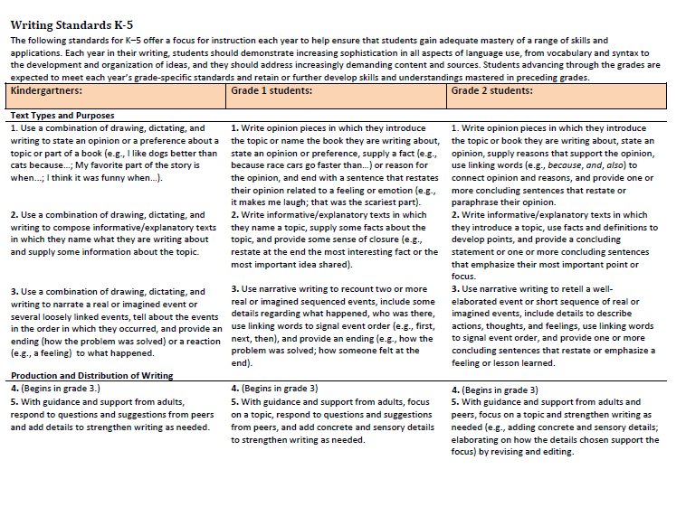
pg 18
Notes:
This the standard that speaks to students learning to produce opinion writings. Here you can see that as early as Kindergarten students are expected to learn the beginning skills of stating, dictating and then writing an opinion or preference. That skill is expected to be refined through all of the grades.

Slide 23
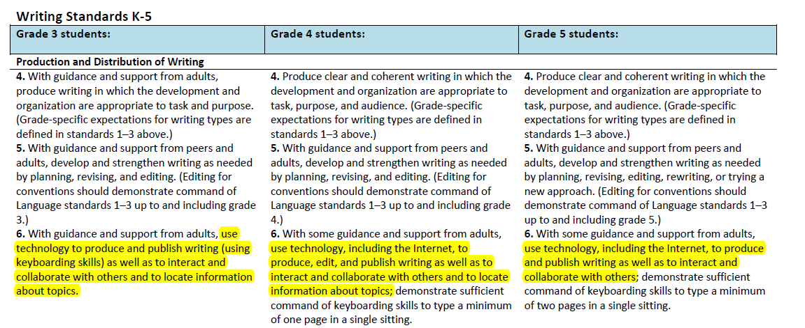
Pg 22
Notes:
standards 6 you will see how the integration of research and technology is woven into these standards. These are the grade level standards for grade 3,4, and 5. However, the idea of using writing research and technology together is established throughout the proposed standards.

Slide 24
Highlights in Speaking and Listening
Supports collaboration
Incorporates technology
Notes:
The two portions of this subject area we will look at is the emphasis on collaborative conversation and the incorporation of technology in presentations.

Slide 25
Notes:
Standard number 1 address collaborative conversation.
Standard number 5 deals with the incorporation of technology.

Slide 26
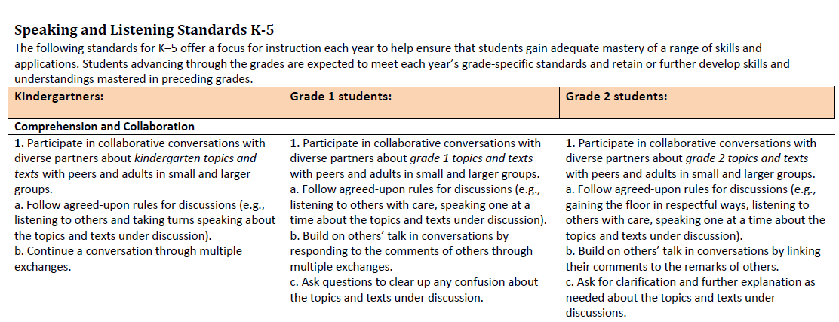
Notes:
Kindergarten students begin honing their ability to communicate in a collaborative conversation. The refinement of that skill can be seen throughout the grades

Slide 27
Notes:
Now let’s look and the integration of technology into the Speaking and listening standards. Here you can see an example in grades 3-5 how students would be expected to use a variety of technological form in a presentation to enhance its effectiveness. You may also notice the progression across the grade level. By grade 5 students are including multimedia in their presentations.

Slide 28
Highlights in Language
Command of conventions
Expand vocabulary
Notes:
Language standard address command of conventions and expanded vocabulary.

Slide 29
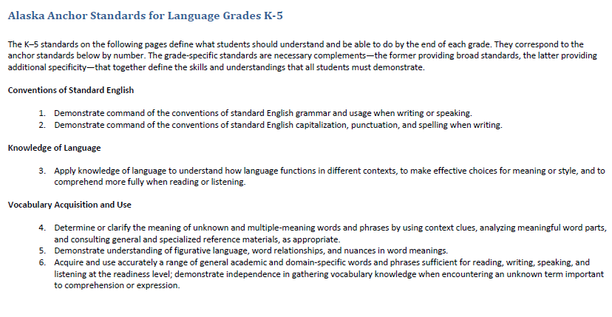
pg.29
Notes:
You can see the standards are divided into strands of Conventions, Knowledge of language and vocabulary. In the proposed standards Vocabulary and conventions are treated in their own strand not because skills in these areas should be handled in isolation but because their use extends across reading, writing, speaking and listening.

Slide 30
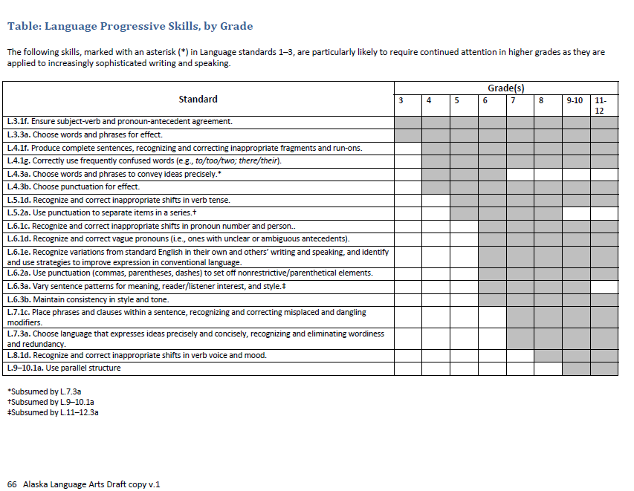
Notes:
Here is a chart that can be found in the standards document. That will help you see the progression across the grades as to which conventions are emphasized.
Let’s take just a moment to examine this chart. The letters and numbers to the left of the page uses the letter L to identify the content area, Language, the number 3 the grade level, the next number is the anchor standard and letter identify the skill cluster. So, the first standard address grade 3 Language standard 1 skill f.
As students advance through the grades they are expected to meet each year’s grade‐specific standards and retain or further develop skills and understandings mastered in preceding grades.

Slide 31
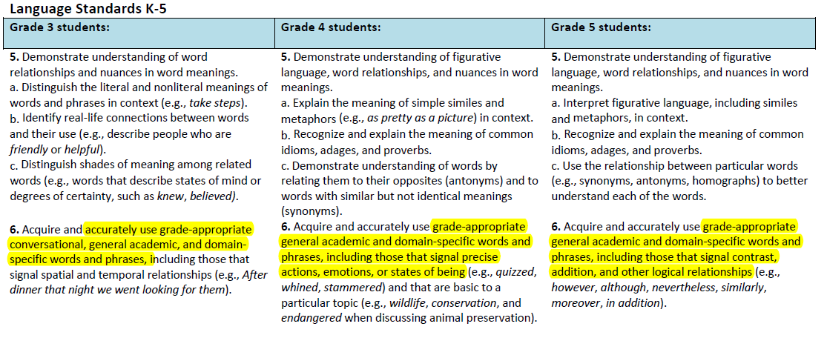
Notes:
students must be able to use formal English in their writing and speaking and helps them prepare for real life experiences at college and in 21st century careers. Vocabulary is an essential part of the communication process.
Standard number 6 expects students to demonstrate the acquisition of not only conversational vocabulary but general academic and domain-specific words as well.

Slide 32
Recap Highlights
Reading
Writing
Speaking and Listening
Language

Slide 33
Support for Districts
EED Website provides tools
Curriculum Alignment Institute supports districts with the transition process
Content Specialist

Slide 34
Contact Information
Karen Melin, Language Arts Content Specialist
karen.melin@alaska.gov, 907-465-6536
Notes:
Here are key contact for the new Standards.

