Slide 1
Alaska Mathematics Standards: Content and Mathematical Practices
Deborah Riddle
Content Specialist
Alaska Department of Education & Early Development

Slide 2
Objectives
Look at the organization of the Standards
Content Standards
Mathematical Practice Standards
Look at Shifts in Mathematics
Strategies to start right away

Slide 3
Mathematics Standards
Address kindergarten – grade 12
Focus critical areas identified in grades k-8
Provide coherence across grades
Establish increased rigor
Present by conceptual categories in high school

Slide 4
Mathematics Standards Organization
Two areas of equal importance
Standards for Mathematical Practice
Standards for Mathematical Content

Slide 5
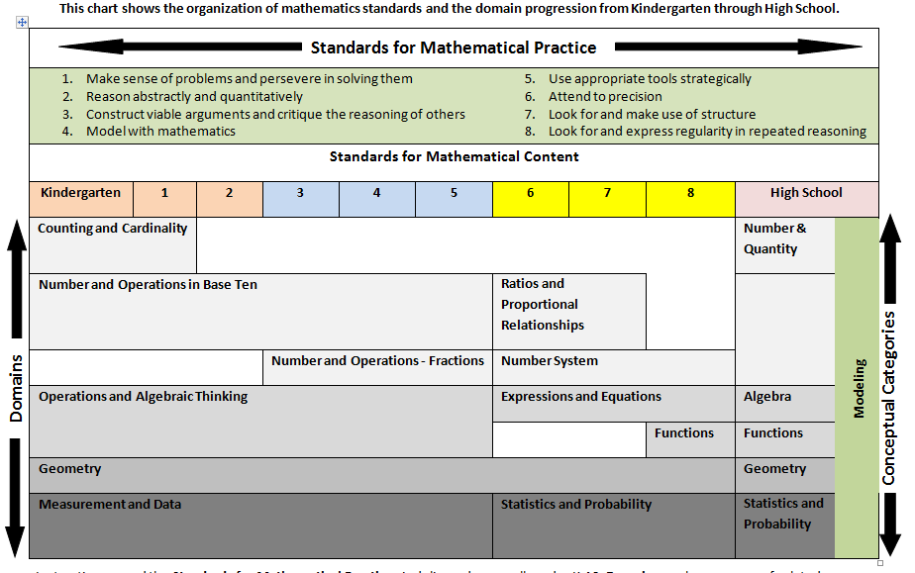
Mathematics Standards Organization

Slide 6
Shift 1
Focus
2-4 topics focused on deeply in each grade
Fewer big ideas to be covered
Allows more time for students to understand the concepts
Strive for understanding not coverage

Slide 7
Focus
The shape of mathematics in A+ countries
Mathematics topics intended at each grade by at least two-thirds of A+ countries
Mathematics topics intended at each grade by at least two-thirds of 21 U.S. States

Slide 8
Shift 1: Focus Multiplication Grade 3
New Math Standards
GLE
Represent and solve problems involving multiplication.
3.OA.1, 3.OA.2, 3.OA.3, 3.OA.4
Understand properties of multiplication and the relationship between multiplication and division.
3.OA.5, 3.OA.6,
Multiply and divide up to 100.
3.OA.7
Solve problems involving the four operations and identify and explain patterns in arithmetic.
3.OA.8, 3.OA.9
Use place value understanding and properties of operations to perform multi-digit arithmetic.
3.NBT.3
M3.1.4 Model multiplication as repeated addition and grouping objects; model division as “sharing equally” and grouping objects
[3] E&C-5, [3]E&C-6
Digging Deeper
Notes:
Provides a focused sense of what to teach.
Teaching with additional depth allows the freedom to let go of some material.
Gets away from rote memorization moving toward mastery.
Depth vs breadth
Provides deep procedural knowledge and conceptual understanding

Slide 9
Shift 1: Focus
Numbers with Operations
Operations and Algebraic Thinking
Expressions and Equations
Algebra
Number and Operations-
Base Ten
The Number System
Number and Operations- Fractions
K 1 2 3 4 5 6 7 8 High School
Grade Level
Notes:
In the GLEs each grade covered all of the 20 Grade level topics.
This graphic represents how the New Alaska Standards cover Numbers with Operations. It shows that students will receive instruction on specific skills in specific grades – not every topic every year. This allows the student to spend the time to master the concepts and skills before moving on. The next grade span will begin instruction with the understanding that the skills have already been taught and that the students can apply what thy have learned to new areas with out having to reteach/review so extensively.
Number and Operations-Fractions is a good example of how focus works. Students don’t begin formal instruction on Fractions until grade 3. During grades 3-5 students will work on mastering fractions. When they enter the sixth grade, there will be very limited instruction on “how to do” fractions. Instead, students will be asked to “apply and extend” their knowledge of fractions to when learning new topics. The teacher should not have to reteach fractions to students after grade 5.

Slide 10
Shift 2
Coherence
Concepts logically connected from one grade to the next
Concepts linked to other major topics within each grade
Deeper learning decreases the need for re-teaching topics each year

Slide 11
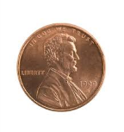
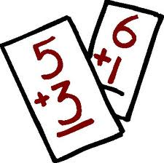
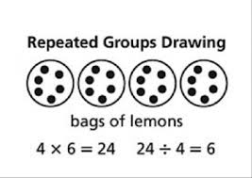
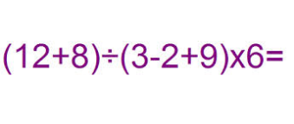
Shift 2: Coherence
Represent addition and subtractions with objects.
Solve single step addition and subtraction word problems.
Estimate and solve multistep addition and subtraction word problems.
Multiplication (repeated addition)
Division (repeated subtraction)
Recognize multiplication as a comparison (commutative property).
Use parentheses to construct numerical expressions and evaluate expressions with these symbols.
Grade Level
K
1
2
3
4
5
K.OA.1
1.OA.1
2.OA.1
3.OA.1, 3.OA.2
4.OA.1
5.OA.1
Craig has $20. He buys 6 squirt guns for $2 each. How much money does he have left?
5x7 = 7x5

Slide 12
Algebra
Notes:
Many students do well in mathematics until they reach algebra. They hit a wall.
The standards help create ramp to help students get up the cliff.
In order to create habits of mind and gain a deep understanding of mathematical concepts:
Students need thoughtful conversation in a vibrant classroom (coherence),
This is not possible in a classroom that is scrambling to cover everything (focus).
All roads lead to Algebra

Slide 13
Shift 3
Rigor
Conceptual understanding
Application to real-world situations
Fluency with arithmetic
With equal intensity

Slide 14
Rigor
Conceptual understanding of key concepts.
Foster students’ ability to access concepts from a number of perspectives
math is seen as more than a set of mnemonics or discrete procedures.

Slide 15
Priorities in Mathematics
Grade | Priorities in Support of Rich Instruction and Expectations of Fluency and Conceptual Understanding
K-2 | Addition and subtraction, measurement using whole numbers
3-5 | Multiplication and division of whole numbers and fractions
6 | Ratios and proportional relationships; early expressions and equations
7 | Ratios and proportional relationships; arithmetic of rational numbers
8 | Linear algebra

Slide 16
Required Fluencies in K-6
Grade | Standard | Required Fluency
K | K.OA.5 | Add/subtract up to 5
1 | 1.OA.6 | Add/subtract up to 10
2 | 2.OA.2 2.NBT.5 | Add/subtract up to 20 (know single-digit sums from memory) Add/subtract up to 100
3 | 3.OA.7 3.NBT.2 | Multiply/divide up to 100 (know single-digit products from memory) Add/subtract up to 1000
4 | 4.NBT.4 | Add/subtract up to 1,000,000
5 | 5.NBT.5 | Multi-digit multiplication
6 | 6.NS.2,3 | Multi-digit division Multi-digit decimal operations
Notes:
Fluent means “fast and accurate”.
Some fluency expectations are meant to be mental and others with pencil and paper. But for each, there should be no hesitation in getting the answer with accruacy.

Slide 17
Application
Students can use appropriate concepts and procedures for application even when not prompted to do so.
Teachers provide opportunities at all grade levels for students to apply math concepts in “real world” situations, recognizing this means different things in K-5, 6-8, and HS.
Teachers in content areas outside of math, particularly science, ensure that students are using grade-level-appropriate math to make meaning of and access science content.

Slide 18
Standards for Mathematical Practice
Embedded standards at every grade level to establish habits of mind that will empower students to become mathematically literate.
Procedural fluency
Development of concepts
Application of knowledge
Self-assessment

Slide 19
Standards for Mathematical Practice
Make sense of problems and persevere in solving them.
Reason abstractly and quantitatively.
Construct viable arguments and critique the reasoning of others.
Model with mathematics.
Use appropriate tools strategically.
Attend to precision.
Look for and make use of structure.
Look for and express regularity in repeated reasoning.

Slide 20
Hexagon Perimeters
Look at the hexagons. As each hexagon is added, the perimeter of the whole figure changes.
What will the perimeter be after the 10th hexagon is added?
What will the perimeter be after the 100th hexagon is added?
How could you determine the perimeter of any number of hexagons you had in the figure?

Slide 21
Mathematical Practice Standard 1
Problem Solving Strategies
Create Drawings
Look for patterns
Work backwards
Consider a simpler case
Estimate solution
Make a table, chart or list
Make sense of problems and persevere in solving them.
Gather Information
Make a Plan
Anticipate possible solutions
Continuously evaluate process
Check results
Question sense of solutions
Notes:
Mathematically Proficient Students:
Explain the meaning of the problem to themselves
Look for a way to start and note the strategies that will help solve the problem.
Identify and analyze givens, constraints, relationships and goals
Make inferences about the form and meaning of the solution
Design a plan to solve the problem
Use effective problem solving strategies
Evaluate the progress and change the strategy if necessary
Solve the problem using a different method and compare solutions
Ask, “Does this make sense?”

Slide 22
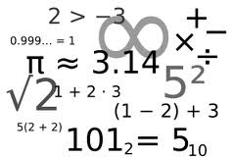
Mathematical Practice Standard 2 | Reason abstractly and quantitatively.
Decontextualize
Represent a situation symbolically and manipulate the symbols
99 ÷ 44 = 2.25
Sample Problem
99 students need to go on a field trip. The busses can carry 44 students each. How many busses do they need?
Mathematical Problem
Will need 3 busses.
Contextualize
Make meaning of the symbols in the problem
Notes:
Mathematically proficient students:
•Make sense of quantities and their relationships in problem solutions.
•Use two complementary abilities when solving problems involving number relationships.
Decontextualize-be able to reason abstractly and represent a situation symbolically and manipulate the symbols
Contextualize- Make meaning of the symbols in the problem
•Understand the meaning of quantities and are flexible in the use of operations and their properties.
•Create a logical representation of the problem
•Attends to the meaning of quantities, not just how to compute them.

Slide 23
Mathematical Practice Standard 3 | Construct viable arguments and critique the reasoning of others.
Use assumptions, definitions and previous results
Create an argument
Make a conjecture
Build a logical progression of statements to explore conjecture
Analyze the situations by breaking them into cases
Recognize and use counter examples
Critique an argument
Support an argument
Distinguish correct logic
Communicate conclusions
Explain flaws
Justify conclusions
Ask clarifying questions
Respond to arguments
Notes:
Mathematically proficient students:
•Analyze problems and used stated mathematical assumptions, definitions, and established results in constructing arguments.
•Justify conclusions with mathematical ideas
•Listen to arguments of others and ask useful questions to determine if an argument makes sense.
•Ask clarifying questions or suggest ideas to improve/revise the argument.
•Compare two arguments and determine correct or flawed logic.

Slide 24
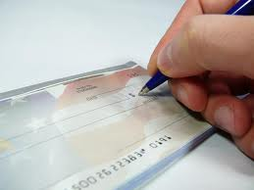
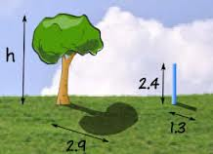
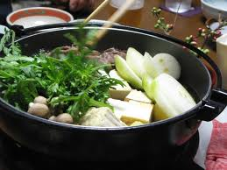
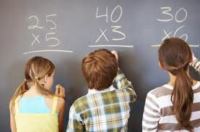
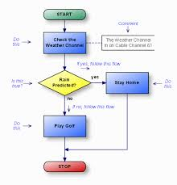
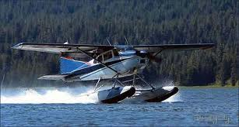
Mathematical Practice Standard 4 | Model with mathematics.
Everyday situations
…reasoned using mathematical methods
Notes:
Mathematically proficient students:
•Understand this is a way to reason quantitatively and abstractly (able to decontextualize and contextualize).
•Apply the math they know to solve problems in everyday life.
•Are able to simplify a complex problem and identify important quantities to look at relationships.
•Represent mathematics to describe a situation either with an equation or a diagram and interpret the results of a mathematical situation.
•Reflect on whether the results make sense possibly improving/revising the model.
•Ask, “ How can I represent this mathematically?”

Slide 25
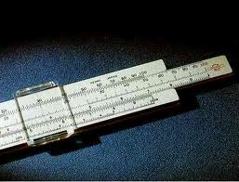
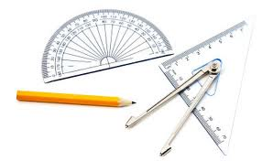
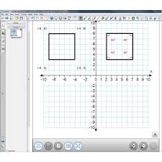
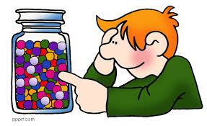
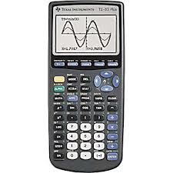
Mathematical Practice Standard 5 | Use appropriate tools strategically.
Use available tools.
Strengths?
Weaknesses?
Estimate
Use technological tools.
Notes:
Mathematically proficient students:
Use available tools recognizing the strengths and limitations of each.
Use estimation and other mathematical knowledge to detect possible errors.
Identify relevant external mathematical resources to pose and solve problems.
Use technological tools to deepen their understanding of mathematics.

Slide 26
Mathematical Practice Standard 6 | Attend to precision.
Precision
Communication
Calculations
Symbols and labels
Precision in solutions
Explain results and reasoning
Significant figures
Accuracy and efficiency
∏ ∑ √
cm² m/sec
Notes:
Mathematically proficient students:
•Communicate precisely with others and try to use clear mathematical language when discussing their reasoning.
•Understand meanings of symbols used in mathematics and can label quantities appropriately.
•Express numerical answers with a degree of precision appropriate for the problem context.
•Calculate efficiently and accurately.

Slide 27
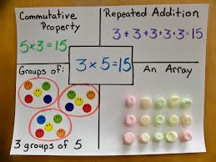
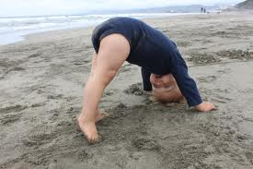
Mathematical Practice Standard 7 | Look for and make use of structure.
Patterns
See complicated things as a single object or as being composed of several objects.
Shift Perspective
Notes:
Mathematically proficient students:
•Apply general mathematical rules to specific situations.
•Look for overall structure and patterns in mathematics.
•See complicated things as single object or as being composed of several objects.
•Be able to look at problems from a different perspective.

Slide 28
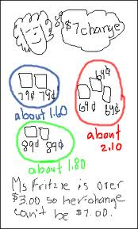
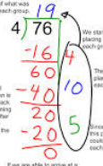
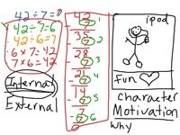
Mathematical Practice Standard 8 | Look for and express regularity in repeated reasoning.
See repeated calculations and look for generalizations
Recognize reasonable solutions
See the process – attend to details
Understand the broader application of patterns
Notes:
Mathematically proficient students:
•See repeated calculations and look for generalizations and shortcuts.
•See the overall process of the problem and still attend to details.
•Understand the broader application of patterns and see the structure in similar situations.
•Continually evaluate the reasonableness of their intermediate results.

Slide 29
Mathematics Standards
Understanding

Slide 30
Performance Tasks
Activities that give students the opportunity to demonstrate their understanding and mastery of math skills and concepts covered in class.
Students
Use an organized approach using one or more strategies
Explain the steps and strategies used to complete the task
Show evidence of checking answers for correctness and reasonableness.
The tasks require analysis to explain the methods used and the reasoning behind choosing the method.
http://insidemathematics.org/index.php/exemplary-lessons-integrating-practice-standards

Slide 31
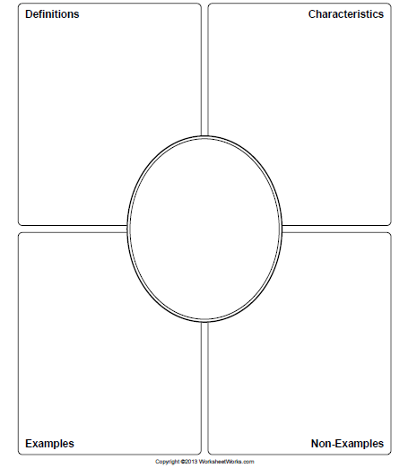
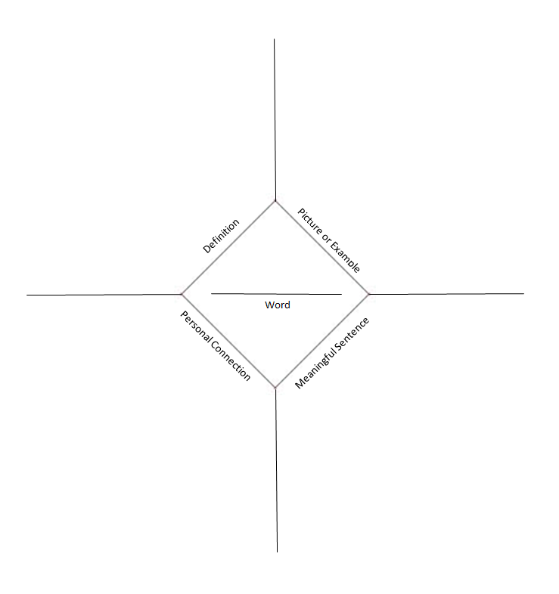
Vocabulary
Frayer Model
WordMap

Slide 32
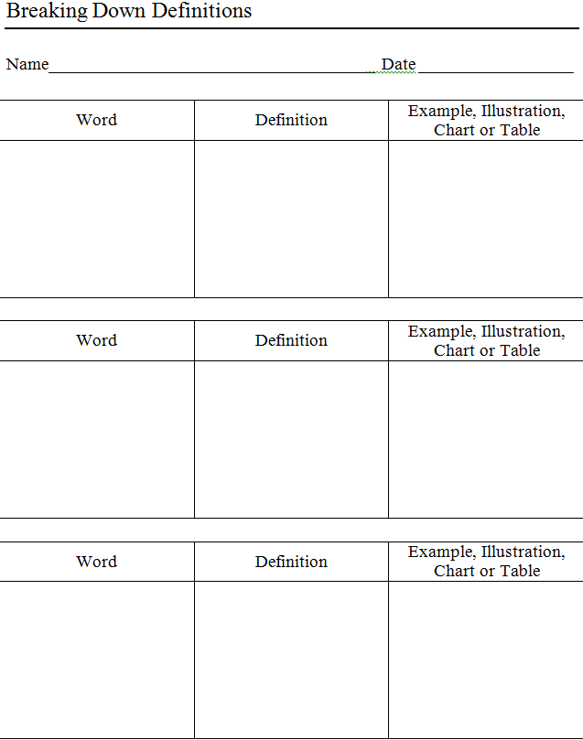
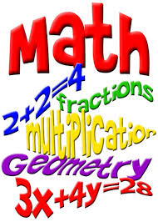
Vocabulary

Slide 33
Math Vocabulary List
From Marzano’s grade level list:
1 | 4 | 8 | Algebra
Addend | Bar graph | Altitude | Binary system
Chart | Diameter | Converse | Divide radical expressions
Height | Equivalent forms | Extrapolate | Exponent
Line | Obtuse angle | Intercept | Matrix
Place order | Pictograph | Predict | Number subsystem
Sum | Ratio | Segment | Polynomial division
tally | transformation | slope | reciprocal

Slide 34
What can you do right now?
Attend to Focus
Incorporate the Math Practices

Slide 35
Contact Information
Deborah Riddle
Math Content Specialist
deborah.riddle@alaska.gov
(907) 465-3758

