Slide 1
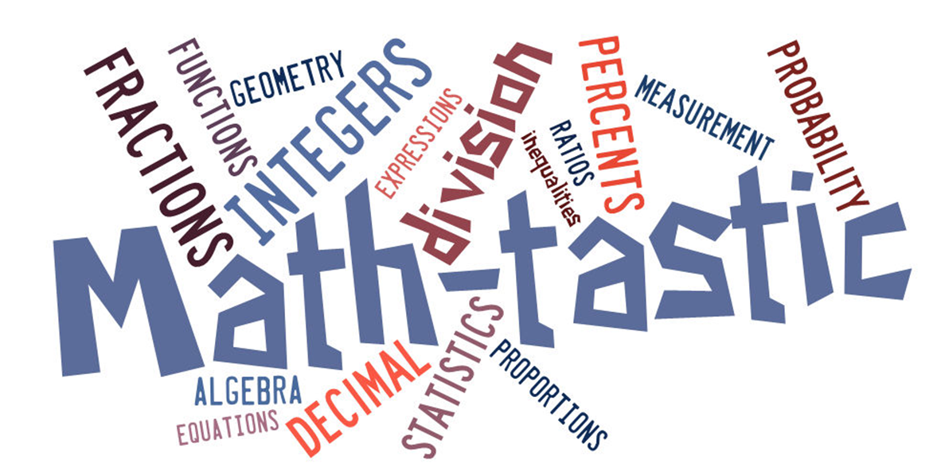
Math & Science Conference
East High School
October 19, 2013

Slide 2
Goals for Today
Instructional Shifts
Math Practices
Problem Solving Recommendations
Performance Tasks
Vocabulary
Resources

Slide 3
Instructional Shifts in Mathematics: The Big Picture
Notes:
FLUENCY is speed and accuracy with simple calculations such as multiplication tables so that students are more able to understand and manipulate more complex concepts.
DEEP UNDERSTANDING is more than “how to get the answer”, it’s the students’ ability to access concepts from a number of perspectives and to demonstrate deep conceptual understanding by applying them to new situations as well as speaking and writing about their understanding.
APPLICATION is the ability of the students’ to apply math concepts in “real world” situations. Teachers in content areas such as science, ensure that students are using math – at all grade levels – to make meaning of and access content.
Dual Intensity is practicing and understanding, both should occur with intensity within the classroom. Teachers create opportunities for students to practice and demonstrate their understanding through extended application of math concepts.

Slide 4
Focus
2 – 4 topics focused on deeply in each grade
Fewer big ideas to be covered
Allows more time for students to understand the concepts
Strive for understanding not coverage

Slide 5
Activity
Find the chart paper that corresponds to your grade/course
Glue the “clusters” by the corresponding instructional focus area
Identify
Content similar to what you teach now (Green)
Content easily added (Yellow)
New content that will require support (Red)
Note the content that you teach that is NOT identified by a “cluster”
Materials:
Chart Paper
Grade level Envelope
Markers/Highlighters
Glue Stick

Slide 6
Coherence
Concepts logically connected form one grade to the next
Concepts linked to other major topics within each grade
Deeper learning decreases the need for
re-teaching topics each year

Slide 7
Algebra
Notes:
Many students do well in mathematics until they reach algebra. They hit a wall.
The standards help create ramp to help students get up the cliff.
In order to create habits of mind and gain a deep understanding of mathematical concepts:
Students need thoughtful conversation in a vibrant classroom (coherence),
This is not possible in a classroom that is scrambling to cover everything (focus).
All roads lead to Algebra

Slide 8
Shift 3: Rigor
Conceptual understanding
Application to real-world situations
Fluency with arithmetic
With equal intensity

Slide 9
NAEP and SBAC
Grade 8
Linear Algebra
NAEP
Grade 8
Linear Algebra
SBAC
https://education.alaska.gov/tls/assessment/naep.html

Slide 10
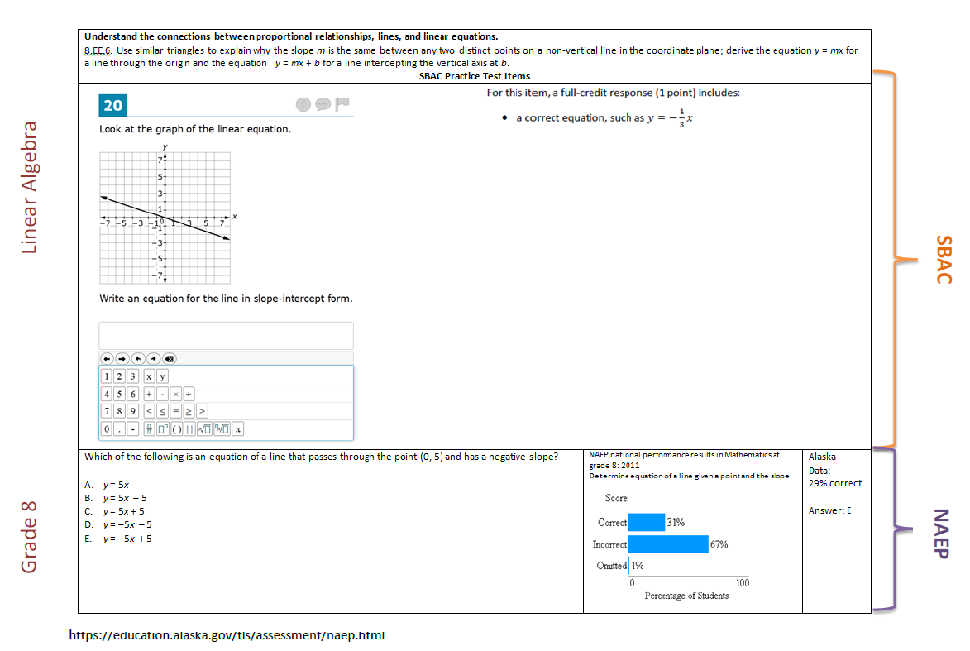

Slide 11
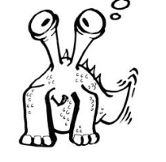
Hopnibs
Make Hopnibs out of these:
All of these are Hopnibs:
2 9 5 30
20 405 1 6
All of these are Hopnibs:
2 9 5 30
20 405 1 6
0
3
90
15
8
11
What is my rule?
______________
What is my rule?
______________
Make your own Hopnibs
Adapted from O’Brien, T. (1980). Wollygoogles and other creatures. Cuisenaire Company.
Notes:
Have the participants do this activity with the people at their table (without any reference to the mathematical practices).
The goal is for them to solve this collaboratively. Later, after reviewing the practices, have them talk about the practices they used.

Slide 12
Mathematical Practice Standard 1
Problem Solving Strategies
Create Drawings
Look for patterns
Work backwards
Consider a simpler case
Estimate solution
Make a table, chart or list
Make sense of problems and persevere in solving them.
Gather Information
Make a Plan
Anticipate possible solutions
Continuously evaluate process
Check results
Question sense of solutions
Notes:
Mathematically Proficient Students:
Explain the meaning of the problem to themselves
Look for a way to start and note the strategies that will help solve the problem.
Identify and analyze givens, constraints, relationships and goals
Make inferences about the form and meaning of the solution
Design a plan to solve the problem
Use effective problem solving strategies
Evaluate the progress and change the strategy if necessary
Solve the problem using a different method and compare solutions
Ask, “Does this make sense?”

Slide 13
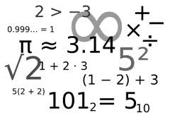
Mathematical Practice Standard 2 | Reason abstractly and quantitatively.
Decontextualize
Represent a situation symbolically and manipulate the symbols
99 ÷ 44 = 2.25
Sample Problem
99 students need to go on a field trip. The busses can carry 44 students each. How many busses do they need?
Mathematical Problem
Will need 3 busses.
Contextualize
Make meaning of the symbols in the problem
Notes:
Mathematically proficient students:
•Make sense of quantities and their relationships in problem solutions.
•Use two complementary abilities when solving problems involving number relationships.
Decontextualize-be able to reason abstractly and represent a situation symbolically and manipulate the symbols
Contextualize- Make meaning of the symbols in the problem
•Understand the meaning of quantities and are flexible in the use of operations and their properties.
•Create a logical representation of the problem
•Attends to the meaning of quantities, not just how to compute them.

Slide 14
Mathematical Practice Standard 3 | Construct viable arguments and critique the reasoning of others.
Use assumptions, definitions and previous results
Create an argument
Make a conjecture
Build a logical progression of statements to explore conjecture
Analyze the situations by breaking them into cases
Recognize and use counter examples
Critique an argument
Support an argument
Distinguish correct logic
Communicate conclusions
Explain flaws
Justify conclusions
Ask clarifying questions
Respond to arguments
Notes:
Mathematically proficient students:
•Analyze problems and used stated mathematical assumptions, definitions, and established results in constructing arguments.
•Justify conclusions with mathematical ideas
•Listen to arguments of others and ask useful questions to determine if an argument makes sense.
•Ask clarifying questions or suggest ideas to improve/revise the argument.
•Compare two arguments and determine correct or flawed logic.

Slide 15
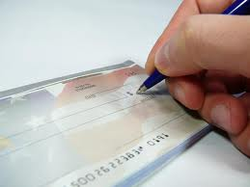
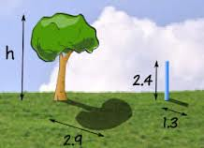
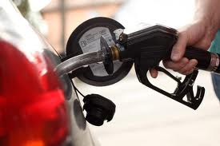
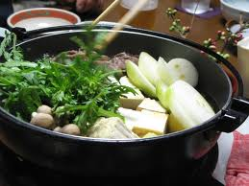
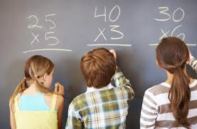
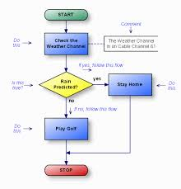
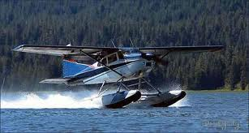
Mathematical Practice Standard 4 | Model with mathematics.
Everyday situations
…reasoned using mathematical methods
Notes:
Mathematically proficient students:
•Understand this is a way to reason quantitatively and abstractly (able to decontextualize and contextualize).
•Apply the math they know to solve problems in everyday life.
•Are able to simplify a complex problem and identify important quantities to look at relationships.
•Represent mathematics to describe a situation either with an equation or a diagram and interpret the results of a mathematical situation.
•Reflect on whether the results make sense possibly improving/revising the model.
•Ask, “ How can I represent this mathematically?”

Slide 16
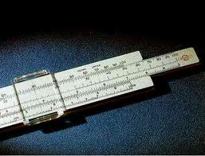
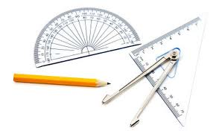
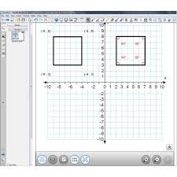
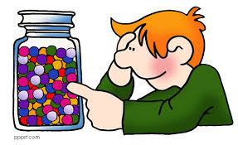
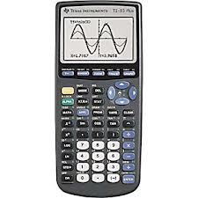
Mathematical Practice Standard 5 | Use appropriate tools strategically.
Use available tools.
Strengths?
Weaknesses?
Estimate
Use technological tools.
Notes:
Mathematically proficient students:
Use available tools recognizing the strengths and limitations of each.
Use estimation and other mathematical knowledge to detect possible errors.
Identify relevant external mathematical resources to pose and solve problems.
Use technological tools to deepen their understanding of mathematics.

Slide 17
Mathematical Practice Standard 6 | Attend to precision.
Precision
Communication
Calculations
Symbols and labels
Precision in solutions
Explain results and reasoning
Significant figures
Accuracy and efficiency
∏ ∑ √
cm² m/sec
Notes:
Mathematically proficient students:
•Communicate precisely with others and try to use clear mathematical language when discussing their reasoning.
•Understand meanings of symbols used in mathematics and can label quantities appropriately.
•Express numerical answers with a degree of precision appropriate for the problem context.
•Calculate efficiently and accurately.

Slide 18
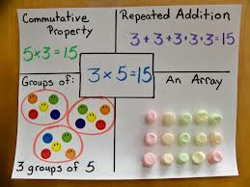
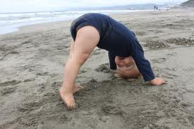
Mathematical Practice Standard 7 | Look for and make use of structure.
Patterns
See complicated things as a single object or as being composed of several objects.
Shift Perspective
Notes:
Mathematically proficient students:
•Apply general mathematical rules to specific situations.
•Look for overall structure and patterns in mathematics.
•See complicated things as single object or as being composed of several objects.
•Be able to look at problems from a different perspective.

Slide 19
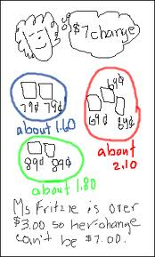
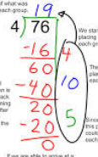
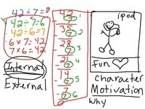
Mathematical Practice Standard 8 | Look for and express regularity in repeated reasoning.
See repeated calculations and look for generalizations
Recognize reasonable solutions
See the process – attend to details
Understand the broader application of patterns
Notes:
Mathematically proficient students:
•See repeated calculations and look for generalizations and shortcuts.
•See the overall process of the problem and still attend to details.
•Understand the broader application of patterns and see the structure in similar situations.
•Continually evaluate the reasonableness of their intermediate results.

Slide 20
The Feedback Carousel Part 1
Materials
Math Practices reference cards
Chart paper
Markers
Get a piece of chart paper and markers.
Identify the significant elements. Describe the meaning of your practice. Use color and creativity.

Slide 21
The Feedback Carousel Part 2
Materials:
Post-It notes
Pen/pencil
N=the practice you worked on
N + 1= the practice you start with (practice 8 goes to practice 1)
Write feedback on a Post-It and place in in the appropriate quadrant.
Rotate through as many practices as time allows.
Notes:
After the groups have finished defining the Eight Mathematical Practices, place a second piece of chart paper next to the “definitions” that is divided into 4 quadrants.
Top left: Clarifying questions
Top right: Probing questions
Bottom left: recommendations for planning
Bottom right: strategies that might be helpful to teachers
Armed with post-it notes and a pencil. Have the participants write feed back and place the feedback in the appropriate quadrant. Given the starting point outlined in the slide, rotate through as many practices as time allows.

Slide 22
Table Talk
Talk with the people at your table.
Which mathematical practices did you use with this activity?
Which Math Practices did you use?
Notes:
Have participants refer back to their Hopnib activity and determine which Mathematical Practices were used.

Slide 23
Recommendations to Improve Problem Solving
NCEE 2012-4055
U.S. Department of Education

Slide 24
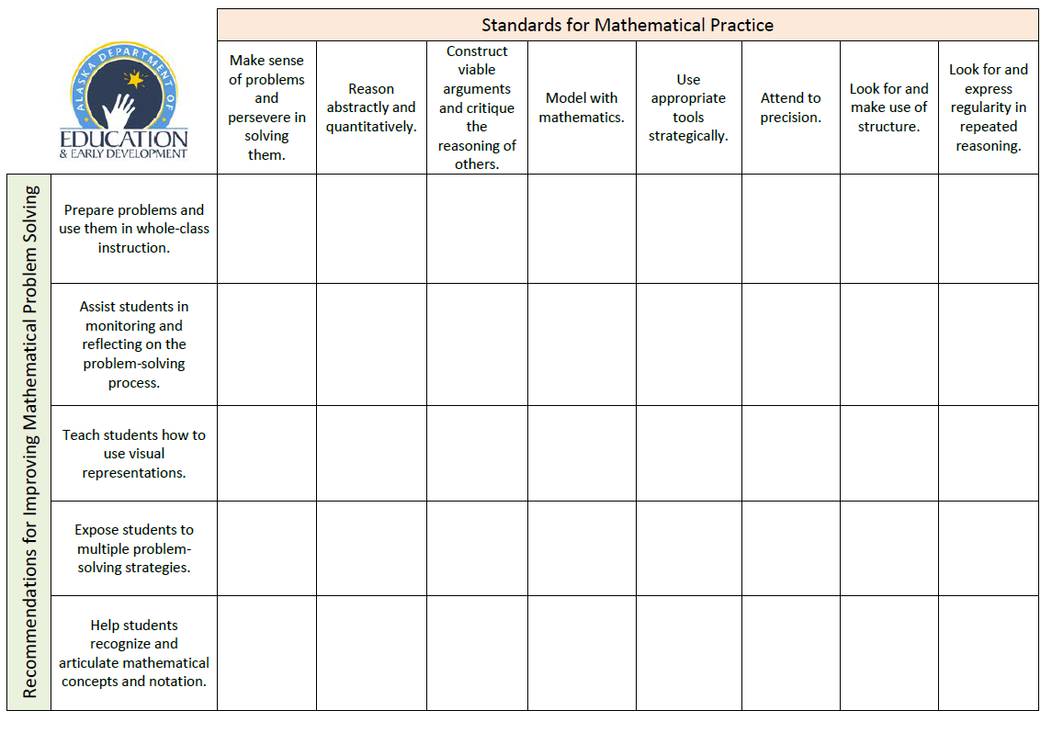
Group Review
Groups of 2-3
Notes:
As we discuss a recommendation, decide which standards of mathematical practice are supported.

Slide 25
Prepare problems and use them in whole-class instruction.
Problem solving activities
routine non-routine
Address issues with context or vocabulary
Consider students’ prior knowledge
Notes:
Include both routine and non-routine problems in problem-solving activities.
Routine- can be solved using methods familiar to the students
Solve problems by using previously learned methods.
One and two step problems student have solved before
Can also be cognitively demanding when additional steps are added that the student might not be familiar with, but capable of figuring out.
Non-routine-
Problems are not predictable
No one pathway suggested
The main goal is for the students to understand the problem and its context before they start to solve it.
Use familiar context
Clarify any unfamiliar language
Reword problems, if necessary, to draw on students’ experiences.
Culturally relevant
Set the students up for success by evaluating their mathematical content knowledge when planning.
The problems should be challenging
Review any mathematical language that might be used in the problems.
Group activity:
Consider any roadblocks teachers might encounter.
What might some solutions be to overcome these roadblocks?

Slide 26
Assist students in monitoring and reflecting on the problem-solving process.
Provide prompts to help students monitor and reflect. Samples
Model how to monitor and reflect.
Use student thinking to help students monitor and reflect.
Notes:
Prompts can either be questions or a task list to help students navigate through the problem.
Questions should require students to think through the problem.
Select a reasonable number of prompts – a long list might be overwhelming.
Prompts help students evaluate their work along the way
Students should justify or explain their response to each prompt.
Model how to reflect using questions
Say aloud the prompt as well as the response and why the steps were taken.
Say which steps were taken and have the students explain why this would work.
Use a prompt for each stage of the problem solving.
Help students clarify and refine the way they monitor their work.
Dialog with students can help guide them in the monitoring and reflecting process.
This can help them refine their problem solving methods.
Group activity:
Consider any roadblocks teachers might encounter.
What might some solutions be to overcome these roadblocks?

Slide 27
Teach students how to use visual representation.
Select appropriate visual representations
Samples
Using visuals: think-alouds
Model how to change a visual representation into mathematical notation
Notes:
Visual representation help students translate quantitative information into a symbolic equation.
Link relationship between the quantities and the mathematical operations needed to solve it.
Include: tables, graphs, charts, diagrams, percent bars, schematic diagrams
Teach a few representations for students to use instead of overwhelming them with too many examples.
Teachers use and teach the visuals that work best for the students regardless of what the curricular materials suggest.
Certain visual representations work better for different purposes.
Examples provided
Strip diagram- works well with fractions.
Schematic diagram- demonstrates the relative sizes and relationships between quantities.
Think Alouds:
Demonstrate the process of taking the problem and putting it into an organizer.
Talk about how you made the decisions you made in the process
Describe how you decided the type of problem (ration, percent, proportion, etc.) and which organizer works best for that type of problem.
Model how to convert the diagram into mathematical notation.
Group activity:
Consider any roadblocks teachers might encounter.
What might some solutions be to overcome these roadblocks?

Slide 28
Expose students to multiple problem-solving strategies.
Teach a variety of strategies
Let students compare different strategies in worked examples
Generating and sharing multiple strategies
Notes:
Provide worked problems for students to look at and compare.
Promote discussions as to the benefits or challenges for each strategy.
Have them
Look at how strategies are similar or different
Tell which strategy they would have used and explain why
Examine how different solution pathways produce the same answer.
The worked problems can also be a guide for students trying a new strategy.
Group activity:
Consider any roadblocks teachers might encounter.
What might some solutions be to overcome these roadblocks?

Slide 29
Help students articulate mathematical concepts and notation.
Relate mathematics to problem solving
Student explanation
Algebraic problem solving

Slide 30
Table Talk
Notes:
Review the chart (Mathematical Practices and Recommendations). How might this information impact your planning.

Slide 31
Mathematics Standards
Understanding
Notes:
A deep understanding of mathematical concepts occurs where the content standards (the what) and the mathematical practices (the how) intersect.

Slide 32
Performance Tasks
Demonstrate mastery
Organized approach using multiple strategies
Fosters self-checking
Explanation of mathematical reasoning
Utilizes Mathematical Practices
http://insidemathematics.org/index.php/exemplary-lessons-integrating-practice-standards
Notes:
Activities that give students the opportunity to demonstrate their understanding and mastery of math skills and concepts covered in class.
Students
Use an organized approach using one or more strategies
Explain the steps and strategies used to complete the task
Show evidence of checking answers for correctness and reasonableness.
The tasks require analysis to explain the methods used and the reasoning behind choosing the method.

Slide 33
Odd Numbers
Kate makes a pattern of squares.
1 x 1
She starts with one square,
then adds three more, then five more,
and so on.
2 x 2
3 x 3
Draw the next shape in her pattern.
How many new squares did she add?
What size square did you make?
Notes:
Have the participants do the Odd Numbers performance task (2 slides) working in pairs.

Slide 34
The total number of squares makes a number pattern.
1 = 1 x 1 = 1
1 +3 = 2 x 2 = 4
1 + 3 + 5 = 3 x 3 = 9
4. Write the next two lines of the number pattern.
5. Use the number pattern to find the total number of
these numbers.
1 + 3 + 5 + 7 + 9 + 11 + 13 + 15 + 17 + 19 =_________
Write down the number pattern that gives a total of 169. Explain your work.
Notes:
This is an example of a performance task that guides students through a process. There is room for open ended thinking and conversation within the structure of the task.
This would be a good example of how a teacher could introduce performance tasks.

Slide 35
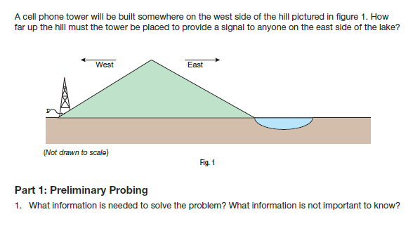
Over the Hill

Slide 36
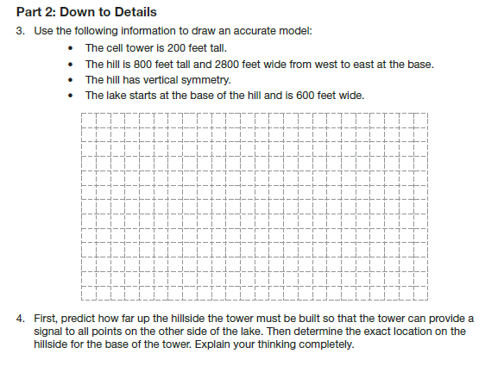
http://www.nctm.org/uploadedFiles/Journals_and_Books/Books/FHSM/RSM-Task/RSM_OverTheHill.pdf

Slide 37
3-Act-Math Tasks
Grab their attention
Movie clip or picture
The story unfolds
Gather information
Resolution
Reveal the answer in a movie clip or picture
Dan Meyer
Notes:
http://mrmeyer.com/threeacts/fallingglowsticks/ Dan Meyer 3-act-math task
http://www.livebinders.com/play/play_or_edit?id=330579 Inspired by 3-act-math-task Uses Big Bang Theory
http://www.youtube.com/watch?v=8OHvrNAfURw Video on how to create 3-act-math-tasks

Slide 38
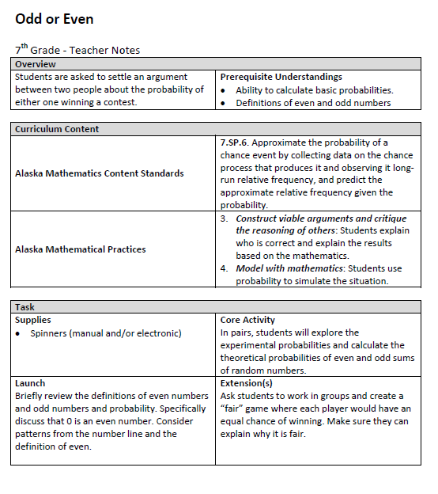
Sample Performance Task
Outline
http://www.mathplayground.com/probability.html

Slide 39
Create a Performance Task

Slide 40
Start with an Idea
Real-world situations
High interest
Relevant

Slide 41
Clarify the Task
Choose a product
Define the purpose and audience
Identify Content Standards and Mathematical Practices
Create clear expectations and goals

Slide 42
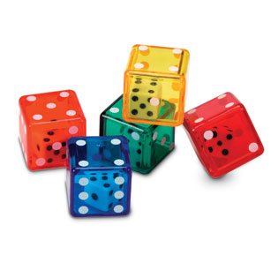
Consider….
Low threshold- high ceiling tasks
Low entry point
Follow directions
Exploration with options
Participants work randomly
Rich tasks
Starts with closed challenge
Offers many routes
Combines fluency with math reasoning
Participants invent questions
Encourages collaboration
Reveals patterns and generalizations
Notes:
Low threshold-high ceiling task
Dice are hyperlinked to the dice activity:
Materials: 3 dice and notecard
Rich tasks activity: Got It.

Slide 43
Prepare for Success
Prepare questions
to assess knowledge
to help struggling students
Identify prerequisite skills necessary for success

Slide 44
Assess Progress
Were the goals met?
Did the product reflect mastery?
Did the task work as intended?

Slide 45
Math Vocabulary List
From Marzano’s grade level list:
1 | 4 | 8 | Algebra
Addend | Bar graph | Altitude | Binary system
Chart | Diameter | Converse | Divide radical expressions
Height | Equivalent forms | Extrapolate | Exponent
Line | Obtuse angle | Intercept | Matrix
Place order | Pictograph | Predict | Number subsystem
Sum | Ratio | Segment | Polynomial division
tally | transformation | slope | reciprocal

Slide 46
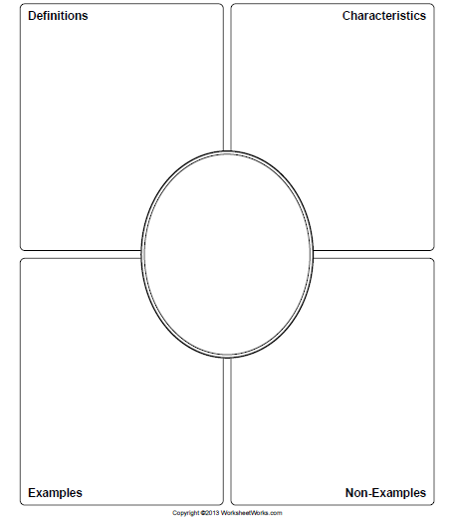
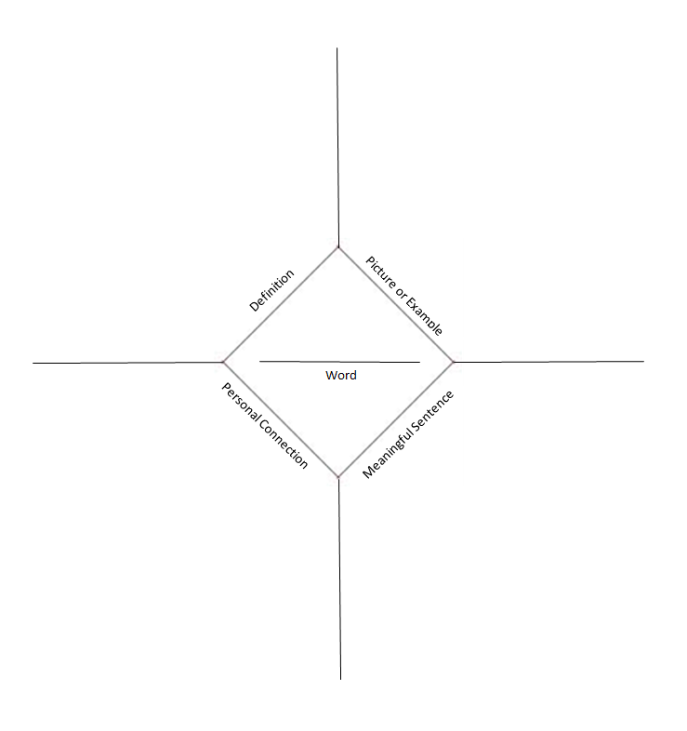
Vocabulary
Frayer Model
Word Map

Slide 47
Vocabulary

Slide 48
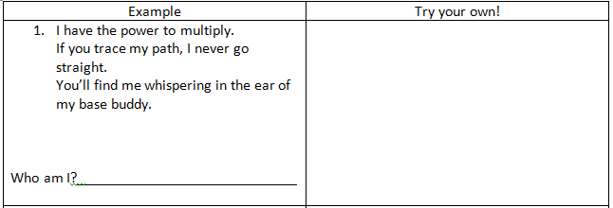
Vocabulary
Riddles

Slide 49
Activity
Groups of 3-4
Choose a vocabulary list
Write the words on Post-It notes
Remain silent
Organize the words into “natural” categories
Move the words notes as necessary
Materials
Vocabulary list
Post-It Notes

Slide 50
Resources
Illustrative Mathematics
Notes:
http://www.nctm.org/rsmtasks/

Slide 51
http://education.alaska.gov

Slide 52
“perseverance plus passion”
Minkel, J. (2013, October 7). [Web log message]. Retrieved from http://blogs.edweek.org/teachers/teaching_for_triumph/2013/10/true_grit.html?cmp=ENL-TU-NEWS1

Slide 53
What can you do right now?
Attend to Focus
Incorporate the Math Practices
Vocabulary

Slide 54
Why this is important.

Slide 55
Contact Information
Deborah Riddle
Math Content Specialist
deborah.riddle@alaska.gov
907-465-3758

Slide 56
Routine Problems
Solve 2y + 15 = 29
Carlos has a cake recipe that calls for 2 ¾ cups of flour. He wants to make the recipe 3 times. How much flour does he need?
Two vertices of a right triangle are located at (4,4) and (0,10). The area of the triangle is 12 square units. Find the point that works as the third vertex.

Slide 57
Non-routine Questions
There are 20 people in a room. Everybody high-fives with everybody else. How many high-fives occurred.
In a leap year, what day and time are exactly in the middle of the year?
Determine angle x without measuring. Explain.
155º
parallel
x
110º

Slide 58
Prompts and Questions
Questions
What is the problem about?
What do I know about the problem so far?
What are some ways I can approach the problem?
Does this solution make sense? I can I verify my solution?
Why did these steps work or not work?
Task List
Identify the givens and goals of the problem.
Identify the problem type.
Recall similar problems to helps solve this problem.
Use a visual to represent and solve the problem.
Solve the problem.
Check the problem.

Slide 59
Visual Representations
Strip diagrams
Eva spent 2/5 of the money she had on a coat and then spent 1/3 of what was left on a sweater. She had $150 remaining. How much did she start with?
1/3 of what was left on a sweater
2/5 on coat

Slide 60
Visual Representations
Schematic Diagram
John recently participated in a 5-mile run. He usually runs 2 miles in 30 minutes. Because of an ankle injury, John had to take a 5-minute break after every mile. At each break he drank 4 ounces of water. How much time did it take him to complete the five mile run.
Start
End
15 | 15 | 15 | 15 | 15
5

