Slide 1
Notes:
Set up: projector, ppt, internet, folders, manuals, posters,
INTRODUCTIONS
-presenters
-participants (name, school, role)
Setting of norms:
-what you can expect from me:
Overview of what STEPP is, why the state is moving to this process for school and district improvement
2. Technical how-to for the on line tool
3. Getting your attention: signal
Group Norms:
Suggested list
Talk about them in table group- any to add?
Please no computers- step outside to do phone calls.
Setting up Partners:
Elbow partners
Across the room partners
Color partners
Go over contents of folder.
QUESTIONING PROTOCOL= SOMETIMES I MAY ASK YOU TO WAIT

Slide 2
Outcomes…
Participants will have a general and broad understanding of Alaska STEPP.
Participants will be able to navigate Alaska STEPP.
Participants will understand and be able to begin to implement the continuous improvement model.
Participants will make connections between their work and the indicators of Alaska STEPP.

Slide 3

Alaska STEPP is an online,
continuous improvement planning tool that puts the emphasis on the process and takes it off of the paperwork.

Slide 4
The Six Domains of Alaska STEPP
  Curriculum
  Assessment
  Instruction
  Supportive Learning Environment
  Professional Development
  Leadership

Slide 5
Alaska STEPP is based on the Continuous Improvement Model
Plan
Implement
Monitor (assess)
Revise (plan)
Assess
Implement
Notes:
Alaska STEPP is a tool that facilitates a shift in the improvement planning process from one year plans addressing only compliance-related requirements to a continuous process of assessing, planning, and self-monitoring.
It assists teams in setting up plans that are strategic because you assess key areas first
It assists teams in avoiding the planning whirlpool with a built in self monitoring mechanism
It adapts to the changing nature of schools by allowing for revisions based on the results of the monitoring

Slide 6
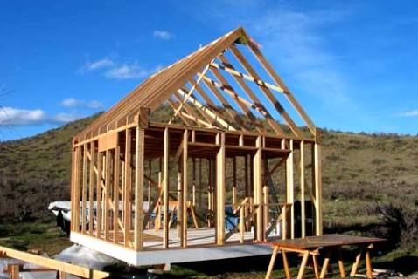
Alaska STEPP is a Framework
It provides school and district teams with an organizational tool for planning & documenting their work.
Notes:
Framework
A place to put all the work you already do
An organizational structure for systematically addressing the challenges you face

Slide 7

Alaska STEPP is a Process
Teams monitor the implementation of their plan over the course of the year.
The plan is never finished and teams continuously assess,
plan, and monitor.
Notes:
Plans are dangerous- they are only useful if you implement them
Stepp does not ensure action, but it does have a structure that is designed to help instructional leaders keep track of the implementation efforts and hold themselves and their teams accountable

Slide 8

Alaska STEPP is Based on Research
The indicators of effective practice are drawn from both national education research and the priorities of the
Alaska Department of Education
& Early Development.
Notes:
The indicators originally came from the Alaska audit tool, developed by the dept to comply with statutes created by the legislature to determine if Alaskan schools were in need of additional support

Slide 9
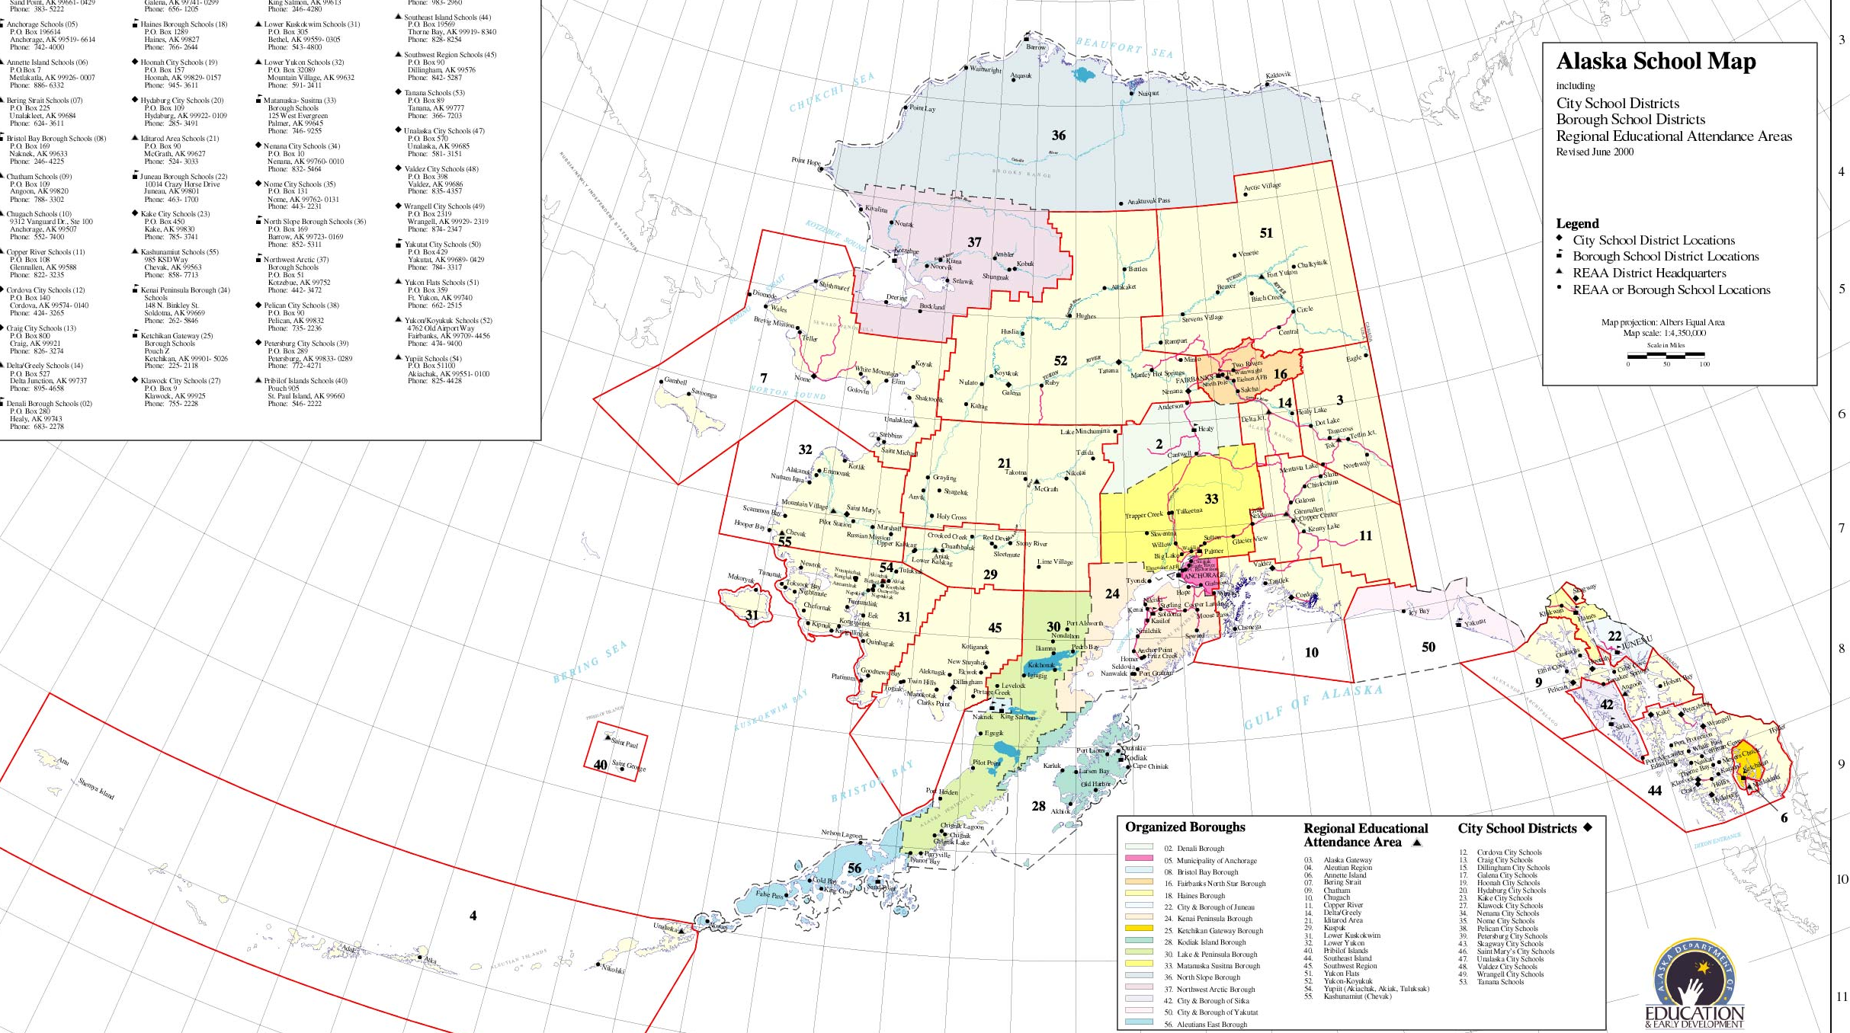
Alaska STEPP is Adaptable
It is designed to be flexible in order to meet the individual needs of Alaska’s diverse schools and districts.
Notes:
Flexible in the following ways:
You determine the pacing guide
You determine where to put the focus
You determine the time line of the plans to match the reality of your school
TURN TO YOUR ELBOW PARTNER AND REVIEW WHAT YOU KNOW SO FAR ABOUT THE BIG PICTURE OF STEPP

Slide 10

Alaska STEPP is a team driven process for school improvement.
Notes:
This process relies on a team- it is not a plan to be written by one person.
Change requires collective capacity or disciplined collaboration. Shared responsibility and shared ownership of everyone working toward the same goal
Clear purpose is widely shared
Priorities on improving instruction
Providing support: pd, resources, flexibility

Slide 11
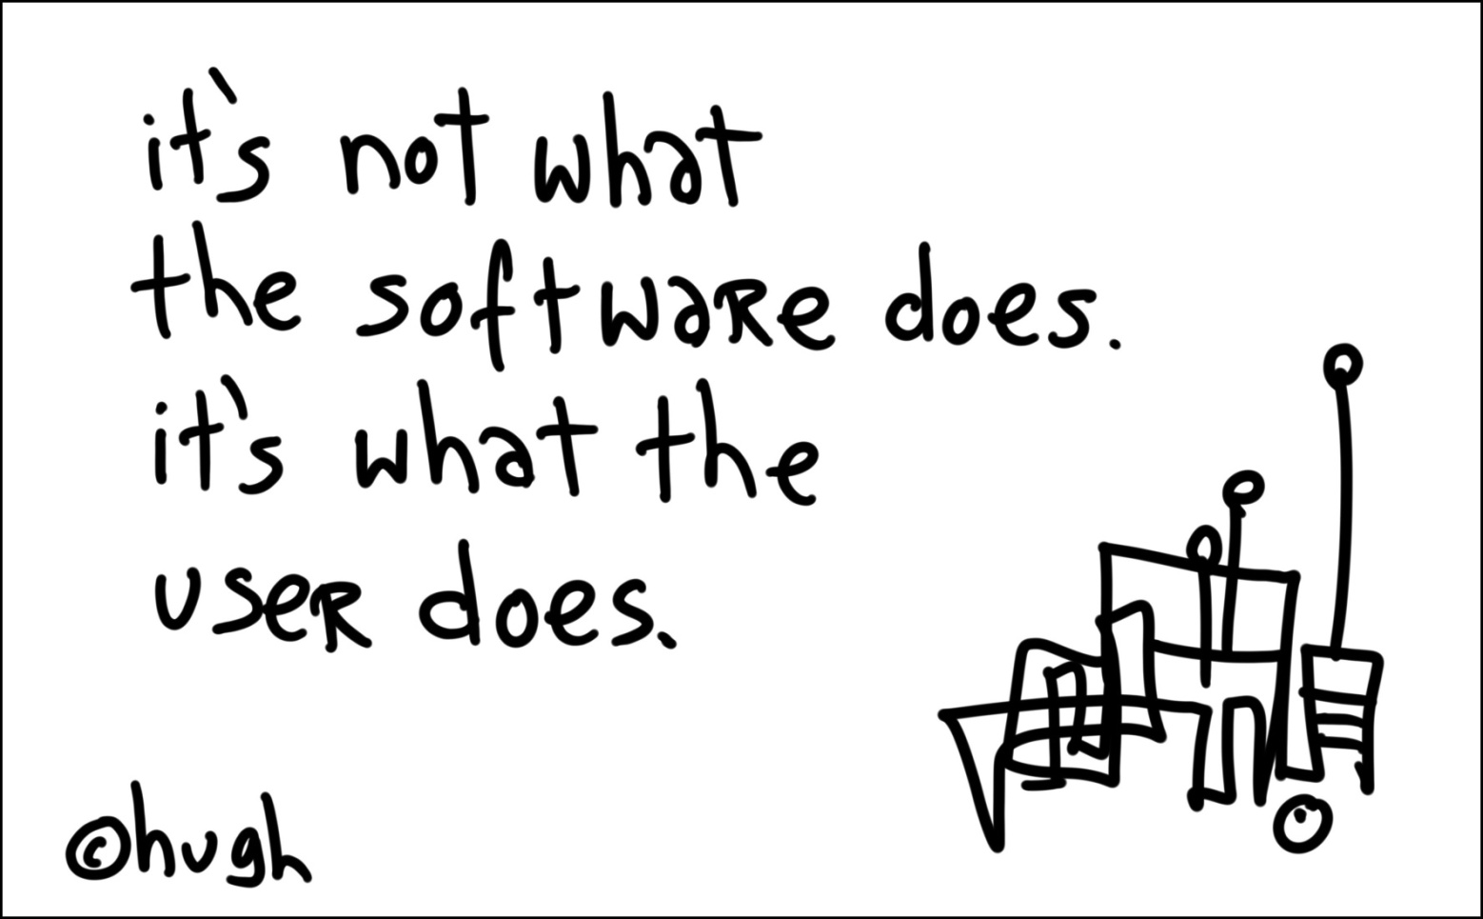
Notes:
It is a tool. It is not a quick fix. This will take you all year.
Year one is the intense year.

Slide 12

Alaska STEPP is:
Continuous
Comprehensive
Team-oriented
Reflect with your elbow partner.
Notes:
Big picture question

Slide 13
Essential Elements of
Alaska STEPP
What? Jigsaw Reading Activity
Why? To dig deeper into the three main elements of the continuous improvement model
How? 1. Find your color partners and read your section.
red-pgs 5-6 green-pg 8 blue-pg 10
2. Dialogue and discuss the content.
3. Create a visual representation of the material.
4. Be ready to teach the content to the entire group.
Notes:
Big picture question

Slide 14
The foundation of Alaska STEPP:
Indicators of Effective Practice
6 Domains
Research-based; Wise Ways
Teams self-assess
Rubrics
Honest and reflective of current level of implementation
Notes:
Big picture question

Slide 15
With your color group, respond to the following questions…
How are the indicators the same or different than you thought?
If you were a principal, how might you use the indicators?
3. In which indicators do you have the most experience and expertise? Which indicators are new to you?
Notes:
Big picture question

Slide 16

With a new-to-you partner…
Work through the
“STEPP Search”
Notes:
Big picture question

Slide 17
Partner Tell-All
1. Partner A tells everything they know about Alaska STEPP for one minute.
2. Partner B tells everything they know about Alaska STEPP for one minute, WITHOUT repeating anything that Partner A said.
Notes:
Big picture question

Slide 18
Concept Attainment Map
What? Teams will create a Concept Attainment Map
Why? To solidify the day’s learning and synthesize concepts
How? With a partner, create a CA Map, following the sample
Notes:
Big picture question

