Slide 1
Phase into the New Standards
Bering Strait School District
2013-2014
Jay Thomas, Kris Busk, Theresa Davis

Slide 2
District-Wide Focus 2013-2014
Reading Anchor Standards 1, 5, and 9
Writing Anchor Standards 2 and 9

Slide 3
Three Shifts in ELA/Literacy
Building knowledge through content rich nonfiction
Reading, writing, and speaking grounded in evidence from text both literary and informational
Regular Practice with complex text and its academic vocabulary

Slide 4
Three Shifts in Math
Focus – 2-3 topics focused deeply in each grade.
Coherence – Concepts logically connected from one grade to the next and linked to other major topics within the grade
Rigor – Fluency with arithmetic, application of knowledge to real-world situations, and deep understanding of mathematical concepts.

Slide 5
Implementation Plan

Slide 6
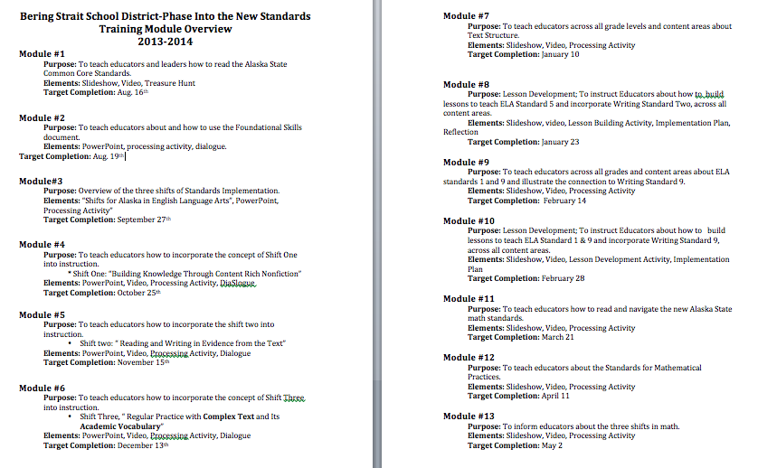
Training Modules

Slide 7
Module 1: Alaska ELA/Literacy and Math Standards Overview
Module # 1 Video
https://www.teachingchannel.org/videos/how-to-read-common-core

Slide 8
Module 2: Foundational Skills K-5
Foundational Skills Resource
http://ela-ccss.pds-hrd.wikispaces.net/Foundational+Skills
Foundational Skills Videos:
Print Concepts: Kindergarten ELA.RF.K.1d
https://www.teachingchannel.org/videos/letter-of-the-week-s-is-for-scarecrow
Phonological Awareness: Kindergarten ELA.RF.K.2c
https://www.teachingchannel.org/videos/teach-phonemics
Fluency: 5 min ELA.RF.5.4a, ELA.RL.5.10
https://www.teachingchannel.org/videos/guided-reading-introduction?fd=1

Slide 9
Module 3: Overview of the Three Shifts
Additional Resources:
Smarter Balance Assessment Consortium
Access to the practice test is available at: http://sbac.portal.airast.org/practice-test/.
A Guide to the Shifts in the ELA Common Core State Standards
http://www.doe.k12.de.us/commoncore/ela/files/ELAInstructionalShifts.pdf

Slide 10
Preparing Students
College and Career Readiness
Rigorous and explicit instruction
Higher expectations
Rigorous assessment
Literacy across the disciplines
Using common vocabulary school and community wide
Administrators
Teachers
Students
Parents
Visual in the classroom and around the school
Frequent informative newsletters and supporting information provided

Slide 11
Informing Parents and Community
School Board and Community
Invite them to attend trainings
Provide opportunities for discussion
Strategic plans implemented by schools
Periodically send home informative articles
Dialogue with parents during parent/teacher conferences
Create opportunities for awareness throughout school year

